Slide 1
New MPJE Blueprint Materials

Slide 2



1.3.2 Scope of authority, scope of practice, and valid registration of all practitioners who are authorized under law to prescribe, dispense, or administer pharmaceutical products, including controlled substances – Regulations relating to retired or deceased prescribers
Sirs Patrick Stewart & Ian
McKellen being cute old
people of retirement age!
I aspire to be a cute
old person eventually!
DEAD OR RETIRED PRESCRIBERS
What do you do when a patient wants to get a refill or get a prescription filled and the prescriber who wrote the prescription is either retired or dead?
Several states have specific regulations for this particular instance telling you exactly what to do which would be a great relief to know. Florida is not one of them! ☺
Therefore, filling or refilling prescriptions from dead or retired prescribers is up to the pharmacist’s professional judgment
The Florida Board of Pharmacy has traditionally viewed it as up to the professional judgment of the pharmacist; their rationale is that the patient-physician relationship was valid at the time the prescription was written, so the refills remaining are valid and the prescription itself is valid.
However, the pharmacist must consider whether it makes sense to fill it – evaluate on a case-by-case basis. How long has it been since the prescription was written? How long has it been since the patient has been seen? Is the prescription expired? (If the prescription is expired, then no one will care if the prescriber is dead, because the prescription itself is dead) What medication/indication is it for?
Other states’ laws find it reasonable to fill a 30 to 90 day supply and advise the patient to find another physician to monitor their condition to make any future adjustments to their dose as necessary – it would be reasonable to do this here as well, in spite of a lack of an actual law
In summary, our state does not have a specific law on this issue, but the Board views it as under the pharmacist’s professional judgment

Slide 3

1.3.2 Scope of authority, scope of practice, and valid registration of all practitioners who are authorized under law to prescribe, dispense, or administer pharmaceutical products, including controlled substances – Internet Prescribing
Internet prescribing laws are considered under the umbrella of telemedicine
Florida’s telemedicine rules are in 64B8-9.0141 Standards for Telemedicine Practice (MDs) and 64B15-14.0081 (DOs), but they are the same
Definition of telemedicine
  Telemedicine IS: The practice of medicine by a licensed Florida physician (this means MDs and DOs) or physician assistant where patient care, treatment, or services are provided through the use of medical information exchanged from one site to another via electronic communications
  Telemedicine IS NOT: an audio only telephone, email messages, text messages, faxes/facsimile transmission, US mail or other parcel service, or any combination of these
Standard of Care for Telemedicine
  The standard of care for telemedicine is the same as it would be if providing services in person
  Florida licensed physicians and physician assistants are held to same standard
  Standard of Care in Fla. Stat. 456.50(1)(e) “Level of care, skill, and treatment recognized in general law related to health care licensure” means the standard of care specified in 766.102 which is:
  “The prevailing professional standard of care for a given health care provider shall be that level of care, skill, and treatment which, in light of all relevant surrounding circumstances, is recognized as acceptable and appropriate by reasonably prudent similar health care providers.”

Slide 4



1.3.2 Scope of authority, scope of practice, and valid registration of all practitioners who are authorized under law to prescribe, dispense, or administer pharmaceutical products, including controlled substances – Internet Prescribing
Florida licensed physicians and physician assistants are responsible for the quality of the equipment and technology employed and are responsible for their safe use
Telemedicine equipment and technology must be able to provide, at a minimum, the same information to the physician and physician assistant which will enable them to meet or exceed the prevailing standard of care for the practice of medicine
Controlled substances shall not be prescribed through the use of telemedicine except for the treatment of psychiatric disorders
  This provision does not preclude physicians or physician assistants from ordering controlled substances through the use of telemedicine for hospitalized patients at a hospital
Prescribing medications based solely on an electronic medical questionnaire constitutes the failure to practice medicine with that level of care, skill, and treatment which is recognized by reasonably prudent physicians as being acceptable under similar conditions and circumstances, as well as prescribing legend drugs other than in the course of a physician’s professional practice
Physicians and physician assistants shall not provide treatment recommendations, including issuing a prescription, via electronic or other means, unless the following elements have been met:
  A documented patient evaluation, including history and physical examination to establish the diagnosis for which any legend drug is prescribed
  Discussion between the physician or the physician assistant and the patient regarding treatment options and the risks and benefits of treatment
  Maintenance of contemporaneous medical records
The practice of medicine by telemedicine does not alter any obligation of the physician or the physician assistant regarding patient confidentiality or recordkeeping
A physician-patient relationship may be established through telemedicine
#1
#2
Physician/patient discussion
#3

Slide 5

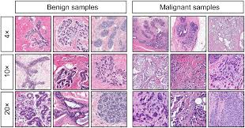
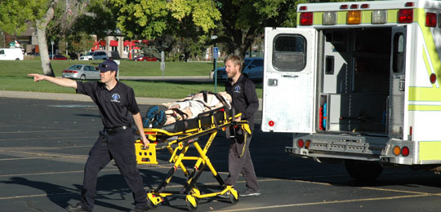
1.3.2 Scope of authority, scope of practice, and valid registration of all practitioners who are authorized under law to prescribe, dispense, or administer pharmaceutical products, including controlled substances – Internet Prescribing
The telemedicine rule:
Does not prohibit consultations between physicians or the transmission and review of digital images, pathology specimens, test results, or other medical data by physicians or other qualified providers related to the care of Florida patients
Does not apply to emergency medical services provided by emergency physicians, emergency medical technicians (EMTs), paramedics, and emergency dispatchers
  Emergency medical services are those activities or services to prevent or treat a sudden critical illness or injury and to provide emergency medical care and prehospital emergency medical transportation to sick, injured, or otherwise incapacitated persons in this state.
Does not apply where a physician or physician assistant is treating a patient with an emergency medical condition that requires immediate medical care
  An emergency medical condition is a medical condition manifesting itself by acute symptoms of sufficient severity that the absence of immediate medical attention will result in serious jeopardy to patient health, serious impairment to bodily functions, or serious dysfunction of a body organ or part.
Does not prohibit patient care in consultation with another physician who has an ongoing relationship with the patient, and who has agreed to supervise the patient’s treatment, including the use of any prescribed medications, nor on-call or cross-coverage situations in which the physician has access to patient records

Slide 6

1.3.2 Scope of authority, scope of practice, and valid registration of all practitioners who are authorized under law to prescribe, dispense, or administer pharmaceutical products, including controlled substances – Internet Prescribing
FLORIDA MEDICAID REIMBURSES FOR TELEMEDICINE SERVICES
59G-1.057 Telemedicine
This rule applies to any person or entity prescribing or reviewing a request for Florida Medicaid services and to all providers of Florida Medicaid services that are enrolled in or registered with the Florida Medicaid program
Telemedicine is the practice of health care delivery by a practitioner who is located at a site other than the site where a recipient is located for the purposes of evaluation, diagnosis, or treatment
Practitioners licensed within their scope of practice to perform the service can provide these services
Florida Medicaid reimburses for telemedicine services using interactive telecommunications equipment that includes, at a minimum audio and video equipment permitting two-way, real time, interactive communication between a recipient and a practitioner
Florida Medicaid does not reimburse for: telephone conversations, chart review(s), electronic mail messages, facsimile transmissions, or equipment required to provide telemedicine services
For practitioners rendering services in the fee-for-service delivery system:
Florida Medicaid reimburses the practitioner who is providing the evaluation, diagnosis, or treatment recommendation located at a site other than where the recipient is located

Slide 7
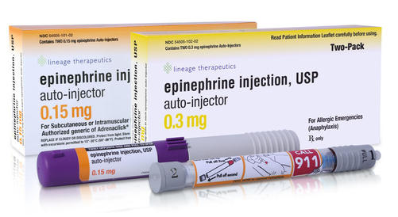
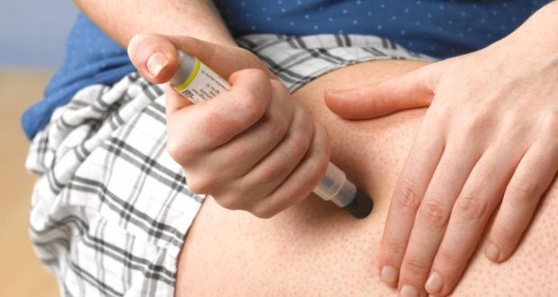
1.3.2 Scope of authority, scope of practice, and valid registration of all practitioners who are authorized under law to prescribe, dispense, or administer pharmaceutical products, including controlled substances – Internet Prescribing
EPINEPHRINE ADMINISTRATION BY NON CERTIFIED INDIVIDUALS IN GOOD FAITH UPON REMOTE AUTHORIZATION BY AN AUTHORIZED HEALTHCARE PRACTITIONER AFTER A CONSULT BY ELECTRONIC COMMUNICATION IS NOT TELEMEDICINE
381.885 (4) Epinephrine auto-injectors; emergency administration.— Expanded availability
Authorized entities that stock epinephrine auto injectors pursuant to a prescription may make the auto injectors available to those not certified to administer emergency allergy treatment to administer to people who they believe in good faith are experiencing an allergic reaction
The entities must store the epi auto-injectors in a locked secure container and make it available only upon remote authorization by an authorized healthcare practitioner after consultation with the practitioner by audio, televideo, or other similar means of electronic communication
Consultation with the practitioner for this purpose is NOT considered the practice of telemedicine

Slide 8
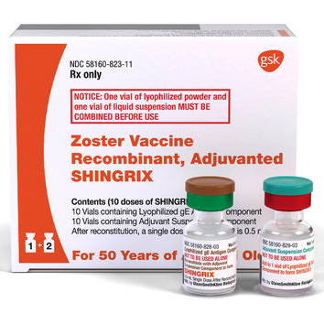
1.3.3 Conditions under which the pharmacist participates in the administration of pharmaceutical products, or in the management of patients’ drug therapy – medication administration (including immunization, vaccines)
NEW VACCINE ADDED
Board of Pharmacy added a new vaccine to the list Florida pharmacists are allowed to administer (changed rule 64B16-27.630 to add Zoster Vaccine Recombinant, Adjuvanted)
Zoster Vaccine Recombinant (Shingrix)
  A 2-dose, subunit vaccine containing recombinant glycoprotein E in combination with a novel adjuvant (AS01B)
  Approved for prevention of herpes zoster in adults age 50 years and older
  2 doses (0.5 ml each), administered intramuscularly, 2–6 months apart
  The recombinant zoster vaccine (RZV) has been recommended by ACIP for use in immunocompetent adults age 50 years and older
Pharmacists are allowed to administer it on or after April 12, 2018

Slide 9
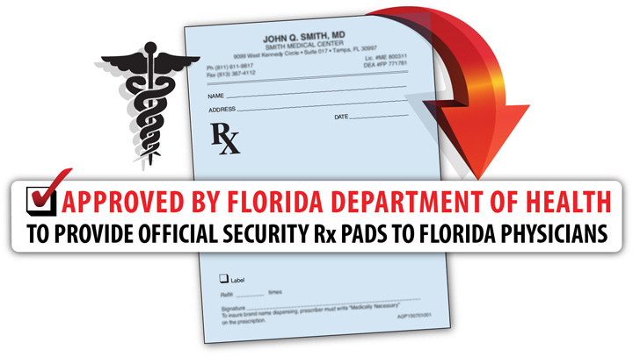
1.3.4 Requirements for issuing a prescription/order – Tamper-Resistant Prescription Forms
64B-3.005 Counterfeit-Proof Prescription Pads or Blanks for Controlled Substance Prescribing
Florida prescribers must use counterfeit-proof blank when writing prescriptions for controlled substances
  But not veterinary prescriptions
The counterfeit-proof prescription pad or blank is not transferable and shall not be used by any person other than the prescribing practitioner whose name appears on the pad or blank or who is authorized to use the pad or blank by the healthcare facility
People or companies interested in making counterfeit-proof prescription pads or blanks for use by prescribing practitioners must apply and be approved by the DOH
To be approved the counterfeit-proof prescription pad/blank must contain:
  Blue or green background color that resists reproduction
  Pad or blank must be printed on artificial watermarked paper
  Pad or blank must resist erasures and alterations
  The word “VOID” or “ILLEGAL” must appear on any photocopy or other reproduction of the pad or blank
    The words must not obstruct or render illegible any portion of the drug name, quantity, or directions for use

Slide 10
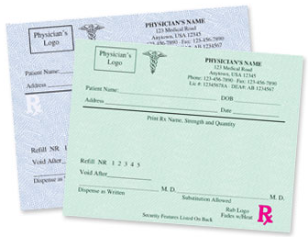
1.3.4 Requirements for issuing a prescription/order – Tamper-Resistant Prescription Forms
64B-3.005 Counterfeit-Proof Prescription Pads or Blanks for Controlled Substance Prescribing
Counterfeit-proof prescription pads or blanks must contain the following information:
  The preprinted name, address and category of professional licensure of the prescribing practitioner or the name and address of the healthcare facility
  A space for the prescribing practitioner’s name if not preprinted and federal Drug Enforcement Administration registration number for controlled substances
  A unique tracking identification number for each order on the front of the counterfeit-proof prescription pad or blank
    The number must consist of three subsets:
      1) a unique alphabetic prefix that must appear in upper case assigned by the DOH that readily identifies the vendor,
      2) the date of printing (must immediately follow the vendors’ unique alpha identifier and must be presented in six character numerical field using the format YRMODY), and
      3) a batch number assigned by the vendor that must immediately follow the print date and consist of numerical characters and must not contain spaces or special characters (e.g., dashes, periods, commas, slashes, alpha characters)
    From left to right, the tracking identification number must appear as alpha prefix, print date, and then batch number, with no blank spaces between subsets
    For example, ABC1801130001
Other requirements found in the Florida application for vendors:
  List security features and descriptions on the prescription blanks, preferably on the reverse side, to assist dispensing pharmacists in detecting forgeries
  Contain no advertisement on the actual prescription blank
    Prescription pads may vary in size and style and contain appropriate advertising on the inside front cover and on alternate sheets within the pad
    Advertisements shall be restricted to medically related topics and must be professional in nature

Slide 11

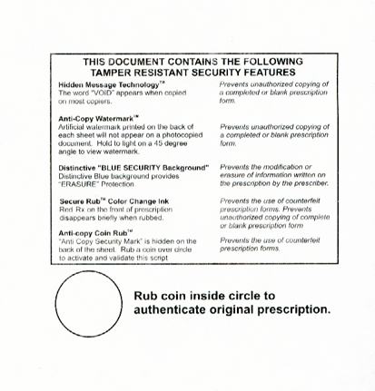
1.3.4 Requirements for issuing a prescription/order – Tamper-Resistant Prescription Forms
64B-3.005 Counterfeit-Proof Prescription Pads or Blanks for Controlled Substance Prescribing
Other requirements found in the Florida application for vendors:
  List security features and descriptions on the prescription blanks, preferably on the reverse side, to assist dispensing pharmacists in detecting forgeries
  Contain no advertisement on the actual prescription blank
    Prescription pads may vary in size and style and contain appropriate advertising on the inside front cover and on alternate sheets within the pad
    Advertisements shall be restricted to medically related topics and must be professional in nature

Slide 12

1.3.4 Requirements for issuing a prescription/order – Tamper-Resistant Prescription Forms
64B-3.005 Counterfeit-Proof Prescription Pads or Blanks for Controlled Substance Prescribing
Approved vendors are responsible for secure production and distribution of the counterfeit-proof prescription pads or blanks to prescribing practitioners
Approved vendors must do all of the following:
  Receive orders in writing signed by an authorized prescribing practitioner or healthcare facility
  Maintain records and information about the production and distribution of counterfeit-proof prescription pads or blanks
    A unique tracking identification number and the name of the authorized prescriber or healthcare facility that purchased the prescription pad or blank must be maintained and made available to the department upon request.
    The department may request random inspections of the counterfeit-proof prescription pads or blanks produced by the vendor;
  Destroy counterfeit-proof prescription pads or blanks unused by the prescriber or healthcare facility for which they were produced and returned to the vendor; and
  Submit a monthly report to the department documenting the name of the prescribing practitioner or healthcare facility who purchased counterfeit-proof prescription pads or blanks, the batch number assigned to the counterfeit-proof prescription pad or blank order, and the number of pads or blanks sold.
    This report must be submitted to the department within 15 business days after the end of the reporting month

Slide 13

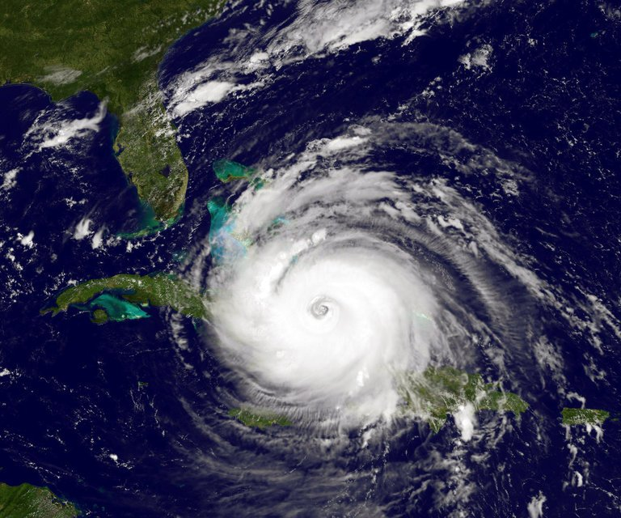
1.3.4 Requirements for issuing a prescription/order – During Emergency Conditions
252.358 Emergency-preparedness prescription medication refills
INSURANCE COMPANIES MUST WAIVE REFILL TOO SOON RESTRICTIONS IN EVENT OF AN EMERGENCY (HURRICANE WARNING, DECLARED STATE OF EMERGENCY, OR EMERGENCY MGMT PLAN ACTIVATION) AND PAY PHARMACIES FOR AT LEAST A 30 DAY SUPPLY OF MEDICATION REGARDLESS OF WHEN IT WAS LAST FILLED
All health insurers, managed care organizations, and other entities that provide prescription medication coverage as part of a policy or contract shall waive time restrictions on prescription medication refills, which include suspension of electronic “refill too soon” edits to pharmacies, to enable insureds or subscribers to refill prescriptions in advance, if there are authorized refills remaining, and shall authorize payment to pharmacies for at least a 30-day supply of any prescription medication, regardless of the date upon which the prescription had most recently been filled by a pharmacist, when the following conditions occur:
  The person seeking the prescription medication refill resides in a county that:
    Is under a hurricane warning issued by the National Weather Service
    Is declared to be under a state of emergency in an executive order issued by the Governor, or
    Has activated its emergency operations center and its emergency management plan
  The prescription medication refill is requested within 30 days after the origination date of the conditions stated in this section or until such conditions are terminated by the issuing authority or no longer exist
  The time period for the waiver of prescription medication refills may be extended in 15- or 30-day increments by emergency orders issued by the Office of Insurance Regulation

Slide 14

1.3.4 Requirements for issuing a prescription/order – During Emergency Conditions
465.0275 Emergency prescription refills
IN A STATE OF EMERGENCY, PHARMACISTS MAY DISPENSE UP TO A 30-DAY SUPPLY JUST AS THEY WOULD THE EMERGENCY 3-DAY REFILL; FOLLOW THE SAME GENERAL PROCEDURE, IT’S JUST FOR 30-DAYS INSTEAD OF ONLY 3 DAYS
In the event a pharmacist receives a request for a prescription refill and the pharmacist is unable to readily obtain refill authorization from the prescriber, the pharmacist may dispense:
  A one-time emergency refill of up to a 72-hour supply of the prescribed medication; or
  A one-time emergency refill of one vial of insulin to treat diabetes mellitus.
If the Governor issues an emergency order or proclamation of a state of emergency, the pharmacist may dispense up to a 30-day supply in the areas or counties affected by the order or proclamation, provided that:
  The prescription is not for a medicinal drug listed in Schedule II appearing in chapter 893
  The medication is essential to the maintenance of life or to the continuation of therapy in a chronic condition
  In the pharmacist’s professional judgment, the interruption of therapy might reasonably produce undesirable health consequences or may cause physical or mental discomfort
  The dispensing pharmacist creates a written order containing all of the prescription information required by this chapter and chapters 499 and 893 and signs that order
    The law does not specify on whether this is the pharmacist’s signature or the prescriber’s – it most likely is the prescriber’s signature, but put both on the prescription just in case to cover your bases – the prescriber signature/name needs to be on it because you can’t fill it under yourself obviously because you’re not a prescriber, so to cover your bases, put both signatures on there; when you fill the 72-hr refills, you fill it under the prescriber as well
  The dispensing pharmacist notifies the prescriber of the emergency dispensing within a reasonable time after such dispensing
Rescuing giant creepy fuzzy friends during emergencies not required under FL law; get Gryffindor friends to help

Slide 15
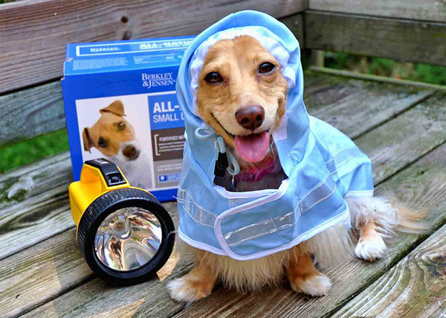
1.3.4 Requirements for issuing a prescription/order – During Emergency Conditions
465.019(2)(b) Institutional pharmacies and emergencies
An institutional pharmacy located in an area under emergency order or proclamation of a state of emergency declared by the Governor may dispense prescriptions to individuals who are not patients of that institution (NORMALLY THEY MUST DISPENSE ON THE PREMISES TO PATIENTS OF THE INSTITUTION FOR USE ON THE PREMISES)
“Class II institutional pharmacies” are those institutional pharmacies which employ the services of a registered pharmacist or pharmacists who, in practicing institutional pharmacy, shall provide dispensing and consulting services on the premises to patients of that institution, for use on the premises of that institution. However, an institutional pharmacy located in an area or county included in an emergency order or proclamation of a state of emergency declared by the Governor may provide dispensing and consulting services to individuals who are not patients of the institution. However, a single dose of a medicinal drug may be obtained and administered to a patient on a valid physician’s drug order under the supervision of a physician or charge nurse, consistent with good institutional practice procedures. The obtaining and administering of such single dose of a medicinal drug shall be pursuant to drug-handling procedures established by a consultant pharmacist. Medicinal drugs may be dispensed in a Class II institutional pharmacy, but only in accordance with the provisions of this section.
The underlined information in blue is important to show what can be done when a pharmacist is not present at an institutional pharmacy – obtaining of a single dose can be performed under supervision of an MD or charge nurse pursuant to procedures created by the consultant pharmacist. N’oublie pas, mes chers!

Slide 16

1.3.4 Requirements for issuing a prescription/order – During Emergency Conditions
64F-12.011 Emergency Drug Distribution and Transfer
DURING STATES OF EMERGENCY OR SHORTAGES, PRESCRIPTION DRUGS MAY BE TRANSFERRED BETWEEN OR TO PHARMACIES AND IT IS NOT CONSIDERED WHOLESALE DISTRIBUTION
Exemption from the definition of wholesale distribution for "emergency medical reasons” includes:
  Transfers of a prescription drug between health care entities or from a health care entity to retail pharmacies to alleviate a temporary shortage of a prescription drug arising from delays in or interruption of regular distribution schedules and should not occur between the parties so as to amount to the health care entity regularly and systematically supplying that drug
  Transfers of prescription drugs in a declared emergency until the state of emergency is lifted, under the following conditions:
    The manufacturer, wholesaler, or other person supplying the prescription drugs is authorized by Florida law to distribute prescription drugs in or into Florida; and
    The prescription drugs are delivered to a temporary emergency medical station, officially designated by the state emergency operation center as a Disaster Medical Assistance Team or State Medical Response Team site;
    The prescription drugs are delivered to a licensed pharmacy
  Transfers of prescription drugs by or on behalf of the Department of Health to a health care entity, licensed medical director of a government agency, or community pharmacy authorized to purchase prescription drugs, for storage and use in the treatment of persons in need of emergency medical services, including controlling communicable diseases or providing protection from unsafe conditions that pose an imminent threat to public health
An aside: If during an emergency, the pharmacy decides to close and wants for whatever reason (like, the pharmacy is flooding) to move their controlled substances to another location, they have to get permission from the DEA to do that. If they don’t have that, they have to leave the drugs there because federal law only allows controlled substances to be stored at the address on the DEA registration certification of the registrant who ordered them*
*Taken from: http://www.fshp.org/?page=ControlledSubstances
Here is FSHP’s link to Emergency Pharmacy Operations laws: http://www.fshp.org/?page=EmergPharmOp

Slide 17
1.3.5 Requirements for the issuance of controlled substance prescriptions/orders –
Time Limits for Dispensing Initial Prescriptions/drug orders
Florida’s Prescribing Limit on Schedule II acute pain prescriptions
Signed by Rick Scott on March 19, 2018 and will go into effect on July 1, 2018
HB 21 – Changes to Prescribing
For acute pain, Schedule II prescriptions for opioid drugs are limited to a 3 day supply, but a 7 day supply may be prescribed if the following conditions are met:
  The prescriber believes in their professional judgment that more than a 3 day supply is “medically necessary” to treat the patient’s pain as an acute medical condition
  The prescriber must indicate “ACUTE PAIN EXCEPTION” on the prescription
  The prescriber must adequately document in the patient’s medical records the acute medical condition and lack of alternative treatment options to justify their deviation from the 3 day supply limit
  For treatment of pain other than acute pain, the prescriber must indicate “NONACUTE PAIN” on the prescription for Schedule II opioid drugs
  An emergency opioid antagonist (naloxone) must be prescribed concurrently whenever a prescriber prescribes a Schedule II controlled substance for a patient with traumatic injury with an Injury Severity Score of 9 or more
Exceptions for cancer, terminal illness, palliative care, traumatic injury (severity score of 9 or greater)
  Acute pain is defined in this law as “the normal, predicted, physiological, and time-limited response to an adverse chemical, thermal, or mechanical stimulus associated with surgery, trauma, or acute illness”
All prescribers of controlled substances must complete a board approved 2 hour CE course and must do so each time they renew their license

Slide 18
1.3.5 Requirements for the issuance of controlled substance prescriptions/orders –
Time Limits for Dispensing Initial Prescriptions/drug orders
Overview of Other State Laws Prescribing Limits for General Knowledge Purposes
Massachusetts passed the first law of this kind in 2016
  As of August 2017, 24 states have passed similar legislation
Most common laws limit first time opioid prescriptions to 7 days
  10 states have 7 day limit (MA, CT, NY, PA, IN, ME, AK, HI, UT, LA)
  1 state has a 14 day limit (NV)
  2 states have a 5 day limit (NC, NJ)
  2 states have a 3-4 day limit (KY, MN)
  Rhode Island has a limit based on morphine milligram equivalents
  7 states set guidelines to another authority (OR, WA, WI, OH, VA, VT, NH)
    Authorities: State Department of Health, Board of Medicine, Nursing, and or Dentistry
Most state laws specify these limits are for acute pain treatment
Some states specify that the limits apply to certain schedules only
  Some examples:
    Schedule II – IV controlled substances
    Schedule II & III controlled substances
    Certain Schedule II & III controlled substances
Most states also create exceptions for:
  Chronic pain treatment
  Cancer pain
  Palliative care
There can also be exceptions for:
  Substance abuse treatment or medication-assisted treatment
  Prescriber’s professional judgment
Most laws require exceptions to prescribing limits if utilized to be documented in the patient’s medical record
Some states have limits on all opioid prescribing for minors regardless of condition (AK, CT, IN, LA, MA, and PA)
  These states may also require counseling for the minor and the parent on the risks associated with the medication

Slide 19
1.3.5 Requirements for the issuance of controlled substance prescriptions/orders –
Time Limits for Dispensing Initial Prescriptions/drug orders
Authority for Prescribing Limits in Case You Were Wondering…
March 2017 – CDC study
  The study concluded the likelihood of becoming addicted to opioids increases with the length of use
  A 3-day prescription → 3 percent chance of developing a long-term addiction
  A 10-day prescription → 20 percent chance
  A 30-day prescription → 30 percent chance
Link to study:
  Shah A, Hayes CJ, Martin BC. Characteristics of Initial Prescription Episodes and Likelihood of Long-Term Opioid Use — United States, 2006–2015. Weekly. 66(10): 265-269.
    https://www.cdc.gov/mmwr/volumes/66/wr/mm6610a1.htm

Slide 20
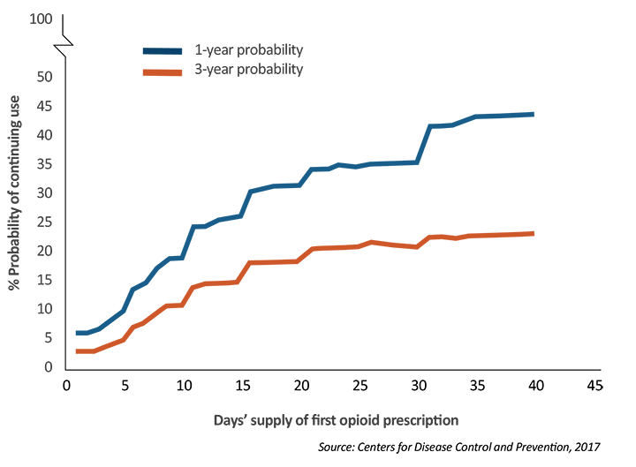
1.3.5 Requirements for the issuance of controlled substance prescriptions/orders –
Time Limits for Dispensing Initial Prescriptions/drug orders
Chart From Authority for Prescribing Limits…again for general knowledge purposes

Slide 21

1.4 Procedures necessary to properly dispense a pharmaceutical product, including controlled substances, pursuant to a prescription/drug order
1.4.1 Responsibilities for determining whether prescriptions/orders were issued for a legitimate medical purpose and within all applicable legal restrictions – RED FLAGS
Red Flags as determined by NABP
Presentation of the Prescription
  Patients travel in groups and/or have unexplainable common factors in their relationships with each other. For example, groups of patients present prescriptions for the same controlled substance(s) from the same prescriber or multiple family members or patients living at the same address present similar controlled-substance prescriptions to the pharmacy on the same day.
  A patient presents prescriptions for controlled substances written in the names of other people. This does not apply to designated caregivers presenting prescriptions for patient.
  A patient presents a prescription for a controlled substance that the pharmacist knows or reasonably believes that another pharmacy refused to fill.
  A handwritten prescription is presented at the pharmacy, looking altered or flawlessly thorough (contains patient address, quantity spelled out, patient's date of birth, multiple provider identifiers, lacks common abbreviations, etc.).
  The pharmacist becomes aware that the prescriber’s Drug Enforcement Agency (DEA)registration has been previously suspended or revoked or is pending suspension or revocation.

Slide 22

1.4 Procedures necessary to properly dispense a pharmaceutical product, including controlled substances, pursuant to a prescription/drug order
1.4.1 Responsibilities for determining whether prescriptions/orders were issued for a legitimate medical purpose and within all applicable legal restrictions – RED FLAGS
Red Flags as determined by NABP
Patient Behavior
  The patient pressures the pharmacist to dispense the controlled substance by making implied or direct threats.
  The patient shows physical signs associated with controlled-substance abuse, such as appearing sedated, confused, intoxicated, or exhibiting withdrawal symptoms.
  The patient obtains the same or a similar controlled-substance prescription from multiple health care practitioners without disclosing those existing controlled-substance prescriptions.
  The patient obtains controlled-substance medications from 1 pharmacy, while having received the same or similar controlled substance(s) from another pharmacy or other pharmacies, without disclosing those existing controlled-substance prescriptions.
  The patient presents prescriptions for highly abused controlled-substance medications, which may vary by region. The pharmacist should be aware of abuse trends in their area.
  The patient presents several prescriptions written for controlled and non-controlled substances but only wants the controlled-substance medication(s) dispensed.
  The patient has a history of untruthfulness when filling controlled-substance prescriptions.

Slide 23

1.4 Procedures necessary to properly dispense a pharmaceutical product, including controlled substances, pursuant to a prescription/drug order
1.4.1 Responsibilities for determining whether prescriptions/orders were issued for a legitimate medical purpose and within all applicable legal restrictions – RED FLAGS
Red Flags as determined by NABP
Medication Taking/Supply
  The patient presents prescriptions for large quantities or large numbers of prescriptions for controlled substances.
  There is therapeutic duplication for 2 or more long-acting and/or 2 or more short-acting opiates.
  The patient presents prescriptions for highly abused “cocktails” (combination of opiate, benzodiazepine, and muscle relaxant) of controlled-substance medications.
Illicit/Illegal
  The patient indicates that drugs will be shared with others or sold.
  The prescriber’s DEA registration or state license has expired or been suspended or revoked.
  The patient presents a prescription from a prescriber who is prescribing outside the scope of his/her practice, as defined by state law.
  The patient alters, forges, sells or rewrites prescriptions.
  The patient is diverting/selling medication or getting drugs from others.

Slide 24

1.4 Procedures necessary to properly dispense a pharmaceutical product, including controlled substances, pursuant to a prescription/drug order
1.4.1 Responsibilities for determining whether prescriptions/orders were issued for a legitimate medical purpose and within all applicable legal restrictions – RED FLAGS
Red Flags from DEA
Prescriptions for large quantities of a “cocktail” or “holy trinity” of opioids, benzodiazepines, and carisoprodol
Diagnosis of “lower lumbar pain” (DEA testified that 90% of pill mill doctors use this diagnosis code)
Pattern prescribing (prescriptions for same drugs and quantities coming from one prescriber)
Shared addresses by customers presenting prescriptions on the same day
Customers going to pharmacy counter with dilated pupils and difficulty concentrating
Physical distance between the doctor, patient, and pharmacy
Patients paying in cash or sometimes using insurance and other times cash
Prescriptions done in “factory-like” manner—no reason to prescribe 15 mg AND 30 mg oxycodone because 30 mg tabs are scored down the middle
Patient uses medicines from multiple physicians or filled at multiple pharmacies (from PDMP)
Inordinately large quantity of controlled substances prescribed
Prescriptions refilled at inconsistent intervals based on quantity
Use of street drug name by patient or prescriber
Suspicion of forged or altered prescriptions
Suspicion of forged or altered ID, or refusal to provide
People who are not regular patrons or residents of the community show up with prescriptions from the same prescriber
file:///C:/Users/ssteinha/Downloads/esplive-aps_2014-05-19_twillman_dea-red-flags.pdf

Slide 25

1.4 Procedures necessary to properly dispense a pharmaceutical product, including controlled substances, pursuant to a prescription/drug order
1.4.1 Responsibilities for determining whether prescriptions/orders were issued for a legitimate medical purpose and within all applicable legal restrictions – MAXIMUM QUANTITIES
There is no maximum quantity that can be dispensed under state or federal law, but there is a state law that says excessive or inappropriate quantities are not in the best interest of the patient and not in the course of the professional practice of pharmacy – BUT STILL NO FEDERAL OR STATE UPPER LIMIT
FS 465.016(1)(i) The following acts constitute grounds for denial of a license or disciplinary action:
  Compounding, dispensing, or distributing a legend drug, including any controlled substance, other than in the course of the professional practice of pharmacy. For purposes of this paragraph, it shall be legally presumed that the compounding, dispensing, or distributing of legend drugs in excessive or inappropriate quantities is not in the best interests of the patient and is not in the course of the professional practice of pharmacy.
893.08(3)(d) The exemptions authorized by this section shall be subject to the following conditions:
  Nothing in this section shall be construed to limit the kind and quantity of any controlled substance that may be prescribed, administered, or dispensed to any person, or for the use of any person or animal, when it is prescribed, administered, or dispensed in compliance with the general provisions of this chapter.
DEA Pharmacists Manual 2010 Edition
  “there are no express federal limits with respect to the quantities of drugs dispensed via a prescription”

Slide 26
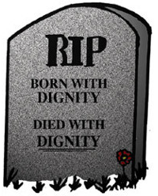
1.4.3 Conditions under which a prescription/order may be filled or refilled –
Death With Dignity
Florida does not have a death with dignity law and is not currently considering it in the legislature
However, there is a Florida law against assisting self-murder!
Fl. Stat. §782.08
  Every person deliberately assisting another in the commission of self-murder shall be guilty of manslaughter (a second degree felony)

Slide 27

1.4.3 Conditions under which a prescription/order may be filled or refilled – Conscience/Moral Circumstances
In Florida, physicians or other persons shall not be prevented from refusing to supply contraceptives for religious reasons and shall not be held liable for refusing
Hospitals or any person or employee shall not be required to participate in an abortion if they have religious objections
Parents do not have to immunize their children if they object on religious grounds
Contraception
Fla. Stat. §381.0051 Family planning – Comprehensive Family Planning Act
  Except as otherwise provided in this section, no medical agency or institution of this state or unit of local government shall interfere with the right of any patient or physician to use medically acceptable contraceptive procedures, supplies, or information or to restrict the physician-patient relationship
  Requires DOH to implement a comprehensive family planning program to educate patients, provide and supply contraceptive prescriptions, perform medical evaluations, treatment for physical complications associated with use of contraceptives, provide services to the public at a readily available location and time, must emphasize service to postpartum mothers, services shall be available to all persons desirous of such services
Fla. Stat. §381.0051(5)
  REFUSAL FOR RELIGIOUS OR MEDICAL REASONS—The provisions of this section shall not be interpreted so as to prevent a physician or other person from refusing to furnish any contraceptive or family planning service, supplies, or information for medical or religious reasons; and the physician or other person shall not be held liable for such refusal

Slide 28
1.4.3 Conditions under which a prescription/order may be filled or refilled – Conscience/Moral Circumstances
In Florida, physicians or other persons shall not be prevented from refusing to supply contraceptives for religious reasons and shall not be held liable for refusing
Hospitals or any person or employee shall not be required to participate in an abortion if they have religious objections
Parents do not have to immunize their children if they object on religious grounds
Childhood Immunizations
Under school entry statutes (§1003.22) and government assistance for low income families (§414.13), parents are generally required to immunize their children, but they can decide not to participate in appropriate childhood immunizations stating objections on religious grounds
Abortion
Termination of Pregnancies §390.0111(8)
  REFUSAL TO PARTICIPATE IN TERMINATION PROCEDURE.—Nothing in this section shall require any hospital or any person to participate in the termination of a pregnancy, nor shall any hospital or any person be liable for such refusal.
  No person who is a member of, or associated with, the staff of a hospital, nor any employee of a hospital or physician in which or by whom the termination of a pregnancy has been authorized or performed, who shall state an objection to such procedure on moral or religious grounds shall be required to participate in the procedure which will result in the termination of pregnancy.
  The refusal of any such person or employee to participate shall not form the basis for any disciplinary or other recriminatory action against such person.

Slide 29
1.4.3 Conditions under which a prescription/order may be filled or refilled – Medical Marijuana
Brief summary of medical marijuana law in Florida
  2014 – Florida passed the Compassionate Medical Cannabis Act of 2014 that allows for the use of low-THC cannabis extract for children with life-threatening epilepsy seizures and a compassionate use registry for cancer and muscle spasm patients
    It authorized 5 dispensaries with 1 retail outlet each – did not open under 2016
      Truelieve was and is an operating dispensary with locations in several cities, including Tampa & Clearwater
  2016 – HB 307 was signed allowing more types of patients to access forms of cannabis for compassionate use
    Seizure patients, patients with severe muscle spasms, pain, nausea, or loss of appetite from cancer or epilepsy, and terminally ill patients who could then access cannabis
    Also for patients who were expected to die within 1 year of diagnosis without life sustaining procedures
    To access the cannabis, the patient had to get 2 doctors (one specialist) to give written informed consent & register patient in compassionate use registry; doctors must pass an 8 hr course and exam on medical marijuana applications
    Smoking cannabis prohibited by the law; patients may vaporize it with specific paraphernalia provided by the dispensary
    Other forms available: tincture, oral syringe, vape pen, and capsules
  November 2016 – Amendment 2 passed on the ballot allowing for creation of a traditional medical marijuana dispensary system in Florida; prior to this only a limited population of patients could access medical cannabis and only certain kinds of marijuana could be sold (low-THC)

Slide 30
1.4.3 Conditions under which a prescription/order may be filled or refilled – Medical Marijuana
Brief summary of medical marijuana law in Florida
  2014 – Florida passed the Compassionate Medical Cannabis Act of 2014 that allows for the use of low-THC cannabis extract for children with life-threatening epilepsy seizures and a compassionate use registry for cancer and muscle spasm patients
    It authorized 5 dispensaries with 1 retail outlet each – did not open under 2016
      Truelieve was and is an operating dispensary with locations in several cities, including Tampa & Clearwater
  2016 – HB 307 was signed allowing more types of patients to access forms of cannabis for compassionate use
    Statute is Fla. Stat. §381.986 Compassionate use of low-THC and medical cannabis
    For seizure patients, patients with severe muscle spasms, pain, nausea, or loss of appetite from cancer or epilepsy, and terminally ill patients who could then access cannabis
    Also for patients who were expected to die within 1 year of diagnosis without life sustaining procedures (basically terminally ill patients)
    To access the cannabis, the patient had to get 2 doctors (one specialist) to give written informed consent & register patient in compassionate use registry; doctors must pass an 8 hr course and exam on medical marijuana applications
    Smoking cannabis prohibited by the law; patients may vaporize it with specific paraphernalia provided by the dispensary
    Other forms available: tincture, oral syringe, vape pen, and capsules
  November 2016 – Amendment 2 passed on the ballot allowing for creation of a traditional medical marijuana dispensary system in Florida; prior to this only a limited population of patients could access medical cannabis and only certain kinds of marijuana could be sold (low-THC)

Slide 31
1.4.3 Conditions under which a prescription/order may be filled or refilled – Medical Marijuana – Fla. Stat. §381.986
Florida passed Amendment 2 which authorizes the creation of traditional medical marijuana dispensaries in Florida; once Amendment 2 was passed statutes and regulations were created to set up the program
The Office of Medical Marijuana Use which is under the Florida Department of Health regulates medical marijuana use in Florida
More specifics on the law:
Became effective on January 3, 2017 and is found in Florida Statute §381.986
Covers all cannabis including low THC cannabis
Requires issuance of ID cards to qualifying patients and patients must obtain physician certification
Written parental consent for minors to obtain drug
A physician may only order low-THC cannabis or medical marijuana if he or she holds an active, unrestricted license as a physician (medical doctor, MD) or an osteopathic physician (doctor of osteopathy, DO)
Qualifying physicians must complete a 2-hour continuing education course and examination. Renewal of the 2-hour course and subsequent examination is required each time the physician renews his or her medical license.
Qualifying physicians can order no more than a 70-day supply and a marijuana delivery device needed by the patient for the medical use of low-THC cannabis or medical marijuana
Qualifying physicians will be listed on a website for patients to access
Law does not allow patients to grow their own low-THC cannabis or medical marijuana at home

Slide 32
1.4.3 Conditions under which a prescription/order may be filled or refilled – Medical Marijuana
The medical use of medical marijuana does NOT include the following (found in Fla. Stat. §381.986(1)(j)):
Possession, use, or administration of marijuana that was not purchased or acquired from a medical marijuana treatment center
Possession, use, or administration of marijuana in a form for smoking, in the form of commercially produced food items other than edibles, or of marijuana seeds or flower, except for flower in a sealed, tamper-proof receptacle for vaping
Use or administration of any form or amount of marijuana in a manner that is inconsistent with the qualified physician’s directions or physician certification
Transfer of marijuana to a person other than the qualified patient for whom it was authorized or the qualified patient’s caregiver on behalf of the qualified patient
Use or administration of marijuana in the following locations:
  On any form of public transportation, except for low-THC cannabis.
  In any public place, except for low-THC cannabis
  In a qualified patient’s place of employment, except when permitted by his or her employer
  In a state correctional institution or a correctional institution
  On the grounds of a preschool, primary school, or secondary school, except as provided in s. 1006.062 (medication administered by the school nurse pursuant to policy and procedure developed by the school board)
  In a school bus, a vehicle, an aircraft, or a motorboat, except for low-THC cannabis

Slide 33
1.4.3 Conditions under which a prescription/order may be filled or refilled – Medical Marijuana
Process for Patients to Obtain Medical Marijuana in Florida
Patients must be diagnosed with a qualifying medical condition
  Patients can locate a qualified physician with a Search database at the Florida Department of Health website: https://appsmqa.doh.state.fl.us/MQASearchServices/MedicalMarijuanaPhysician
Qualifying conditions include:
  Cancer
  Epilepsy
  Glaucoma
  HIV/AIDS
  Post-traumatic stress disorder (PTSD)
  Amyotrophic lateral sclerosis (ALS)
  Crohn’s disease
  Parkinson’s disease
  Multiple sclerosis (MS)
  Medical conditions of the same kind or class as or comparable to those above
  Also, a terminal condition diagnosed by a physician other than the qualified physician issuing the physician certification
  And chronic nonmalignant pain caused by a qualifying medical condition or that originates from a qualifying medical condition and persists beyond the usual course of that qualifying medical condition

Slide 34
1.4.3 Conditions under which a prescription/order may be filled or refilled – Medical Marijuana
How Do Physicians Become Qualified?
Must complete a 2 hour course and examination – must do this before initial approval and before each license renewal
  If a physician was already qualified under the existing Florida laws for low-THC cannabis, they have a grace period of up until 90 days after the course and exam become available
May not be employed by or have a direct or indirect economic interest in a medical marijuana treatment center or marijuana testing laboratory
If an MD or DO wants to be a medical director, they must also complete a 2 hour course and exam
The department shall publish a list of all approved medical marijuana treatment centers, medical directors, and qualified physicians on its website, so patients and authorities can find them

Slide 35
1.4.3 Conditions under which a prescription/order may be filled or refilled – Medical Marijuana
What criteria must caregivers meet?
A caregiver must:
  Not be a qualified physician and not be employed by or have an economic interest in a medical marijuana treatment center or a marijuana testing laboratory
  Be 21 years of age or older and a Florida resident
  Agree in writing to assist with the qualified patient’s medical use of marijuana
  Be registered in the medical marijuana use registry as a caregiver for no more than one qualified patient, unless they meet one of the exceptions below
  Successfully complete a caregiver certification course which must be renewed biennially
  Pass a background screening unless the patient is a close relative of the caregiver (Close relatives are defined as spouse, parent, sibling, grandparent, child, or grandchild, whether related by whole or half blood, by marriage, or by adoption)
A qualified patient may designate no more than one caregiver to assist with the qualified patient’s medical use of marijuana, unless:
  The qualified patient is a minor and the designated caregivers are parents or legal guardians of the qualified patient;
  The qualified patient is an adult who has an intellectual or developmental disability that prevents the patient from being able to protect or care for himself or herself without assistance or supervision and the designated caregivers are the parents or legal guardians of the qualified patient; or
  The qualified patient is admitted to a hospice program.
A caregiver may be registered in the medical marijuana use registry as a designated caregiver for no more than one qualified patient, unless:
  The caregiver is a parent or legal guardian of more than one minor who is a qualified patient;
  The caregiver is a parent or legal guardian of more than one adult who is a qualified patient and who has an intellectual or developmental disability that prevents the patient from being able to protect or care for himself or herself without assistance or supervision; or
  All qualified patients the caregiver has agreed to assist are admitted to a hospice program and have requested the assistance of that caregiver with the medical use of marijuana; the caregiver is an employee of the hospice; and the caregiver provides personal care or other services directly to clients of the hospice in the scope of that employment.
A caregiver may not receive compensation, other than actual expenses incurred, for any services provided to the qualified patient.
If a qualified patient is younger than 18 years of age, only a caregiver may purchase or administer marijuana for medical use by the qualified patient. The qualified patient may not purchase marijuana.
A caregiver must be in immediate possession of his or her medical marijuana use registry identification card at all times when in possession of marijuana or a marijuana delivery device and must present his or her medical marijuana use registry identification card upon the request of a law enforcement officer.

Slide 36
1.4.3 Conditions under which a prescription/order may be filled or refilled – Medical Marijuana
Process for Patients to Obtain Medical Marijuana in Florida continued
Patients and Caregivers are entered into the Medical Marijuana Use Registry by their Qualified Physician
  Physician gives patient their Patient ID Number
  Patients & Caregivers then apply for Registry Identification Cards – can be electronically or by paper application and pay $75 fee
  Applications available here: http://www.floridahealth.gov/programs-and-services/office-of-medical-marijuana-use/registry-id-cards/index.html ; Paper application: http://www.floridahealth.gov/programs-and-services/office-of-medical-marijuana-use/_documents/identification-card-for-patient.pdf
  ID cards expire 1 year after date of approval; to stay active, patients must submit a renewal application 45 days prior to expiration along with the fee; registry is connected to the DMV, so they transfer your driver’s license photo to your application if it matches their info
  Patients and caregivers must have an approved ID card application before they can fill an order for medical marijuana
  Caregivers must be 21, must be a Florida resident, must agree in writing to assist the patient, and must be limited to 1 qualified patient unless exempted; must successfully complete a caregiver certification course and renew it biennially; must pass a background screening unless the patient is a close relative of the caregiver; caregivers may not be a qualified physician, may not be employed by or have economic interest in a medical marijuana treatment center, may not receive compensation for services other than actual expenses incurred for any services provided to the patient, and other information we went over previously
Patients will fill their order at licensed Medical Marijuana Treatment Center
  ID card must be approved, then can find a place to fill it
  All marijuana purchased must remain in its original packaging
  Licensed medical marijuana treatment center list: http://www.floridahealth.gov/programs-and-services/office-of-medical-marijuana-use/medical-marijuana-treatment-centers/index.html

Slide 37
1.4.3 Conditions under which a prescription/order may be filled or refilled – Medical Marijuana
Process for Patients to Obtain Medical Marijuana in Florida continued
Before they can fill an order, the physician must produce a certification that the patient is authorized to receive the medical marijuana
Requirements for Physician Certification of a patient
Physical examination while present in the same room as the patient and a full assessment of patient’s medical history
Diagnose patient with at least one qualifying condition
Determine the medical use of marijuana likely outweighs health risks and document that in the record
  For patients under 18 years of age, have a second physician agree in writing that medical use of marijuana likely outweighs the health risks for that minor patient
Determine if the patient is pregnant. If the patient is pregnant, it must be documented in that patient’s medical record and only low-THC cannabis certification can be given to that patient during the pregnancy.
Review the patient’s history in the PDMP database
Confirm the patient does not already have an active certification from another physician in the Medical Marijuana Use Registry
Physician must register as the physician issuing the certification to that qualified patient in the registry
Obtain voluntary and informed written consent each time a physician certification is provided to the patient and keep that with the patient’s medical record. The approved informed consent form containing all legal requirements is available from the Board of Medicine and Board of Osteopathic Medicine.
http://www.flhealthsource.gov/ommu/physician_requirements

Slide 38
1.4.3 Conditions under which a prescription/order may be filled or refilled – Medical Marijuana
Process for Patients to Obtain Medical Marijuana in Florida continued
Before they can fill an order, the physician must produce a certification that the patient is authorized to receive the medical marijuana
What is in the informed consent form given to patients?
The Federal Government’s classification of marijuana as a Schedule I controlled substance
The approval and oversight status of marijuana by the Food and Drug Administration
The current state of research on the efficacy of marijuana to treat the qualifying conditions set forth in this section
The potential for addiction
The potential effect that marijuana may have on a patient’s coordination, motor skills, and cognition, including a warning against operating heavy machinery, operating a motor vehicle, or engaging in activities that require a person to be alert or respond quickly
The potential side effects of marijuana use
The risks, benefits, and drug interactions of marijuana
That the patient’s de-identified health information contained in the physician certification and medical marijuana use registry may be used for research purposes
http://www.flhealthsource.gov/ommu/physician_requirements

Slide 39
1.4.3 Conditions under which a prescription/order may be filled or refilled – Medical Marijuana
Process for Patients to Obtain Medical Marijuana in Florida continued
The physician must produce a certification that the patient is authorized to receive the medical marijuana
How Physician Issues Certification
After the physician registers as the patient's certifying physician in the registry, the physician can enter the contents of the certification into the registry for that qualified patient.
The contents include:
  the qualifying condition of the patient
  dosage of medical marijuana not to exceed the daily dose amount determined by Department rule
  the amount of medical marijuana or low-THC cannabis authorized for the qualified patient
  the form of medical marijuana or low-THC cannabis authorized for the qualified patient
  the medical marijuana delivery devices the patient needs for the medical use of the physician’s certification
The physician can place no more than 3 orders for a maximum of 70-days per order as part of a physician certification for the qualified patient. Thereafter, the physician must issue a new certification, complying with all of the initial certification requirements and additional requirements
If the physician wishes to make a change to the original certification for the patient, they must update the registry within 7 days of making that change.
http://www.flhealthsource.gov/ommu/physician_requirements

Slide 40
1.4.3 Conditions under which a prescription/order may be filled or refilled – Medical Marijuana
Process for Patients to Obtain Medical Marijuana in Florida continued
The physician must produce a certification that the patient is authorized to receive the medical marijuana
How Physician Issues Certification
The physician can place no more than 3 orders for a maximum of 70-days per order as part of a physician certification for the qualified patient. Thereafter, the physician must issue a new certification, complying with all of the initial certification requirements and additional requirements
  The physician may request an exception to this limit on an electronic form containing this information:
    The qualified patient’s qualifying medical condition
    The dosage and route of administration that was insufficient to provide relief to the qualified patient
    A description of how the patient will benefit from an increased amount
    The minimum daily dose amount of marijuana that would be sufficient for the treatment of the qualified patient’s qualifying medical condition
  The physician must provide the patient’s records if requested by the department
  The department shall approve or disapprove the request within 14 days after receipt of the complete documentation
  The request shall be deemed approved if the department fails to act within this time period
http://www.flhealthsource.gov/ommu/physician_requirements

Slide 41
1.4.3 Conditions under which a prescription/order may be filled or refilled – Medical Marijuana
Process for Patients to Obtain Medical Marijuana in Florida continued
If the patient needs refills, the physician must reissue a certification.
How Physician Reissues Certification
For subsequent certifications for the qualified patient which must occur at least once every 30 weeks:
  Conduct an in person physical exam while in the same room as the qualified patient
  Determine if the patient still meets all the requirements to be issued a physician certification as the physician determined at the time of the first certification
  Identify and document in the medical record for the patient whether the patient experienced an adverse drug interaction with any prescription or nonprescription medication with medical marijuana
  Identify and document in the medical record for the patient whether the patient experienced a reduction in use of, or dependence on, other types of controlled substances
  Submit a report to the Department including the information obtained from the patient regarding adverse reactions or reduction in use or dependence on controlled substances as a result of the patient’s medical use of marijuana – reports are given to the Coalition for Medical Marijuana Research and Education
ID Cards Generally
Information on them: Name, address, DOB, photo taken within 90 days before registration or photo from the DMV from your state ID/driver’s license, designation as a patient or caregiver, unique numeric identifier, expiration date
Fill out a form, $10 of the fee for the card goes to research at FAMU to educate minorities about marijuana use and its impact of unlawful use on minority communities
If the card is revoked, the patient or caregiver shall return it to DOH within 5 days of having it revoked
http://www.flhealthsource.gov/ommu/physician_requirements

Slide 42
1.4.3 Conditions under which a prescription/order may be filled or refilled – Medical Marijuana
Process for Patients to Obtain Medical Marijuana in Florida continued
If the physician elects to certify a patient with a qualifying condition that is classified under the “medical conditions of the same kind or class as or comparable to those enumerated” category in the law – in other words, the “other” category of qualified conditions that is not directly spelled out in the law, the physician must submit to the Board within 14 days after issuing the certification for the qualified patient documentation required under 381.986(4)(b) – (I looked it up: this is documentation supporting the physician's opinion that the patient has a qualifying medical condition, the marijuana is efficacious for treatment of the condition, and documentation supporting the physician’s opinion that the benefits of medical marijuana use outweigh potential health risks)
If the physician no longer recommends the medical use of marijuana for the patient, they must deactivate that patient’s registration and the registration of any caregiver for the patient
The Board of Medicine and the Board of Osteopathic Medicine have forms with all this required documentation information.
Medical Marijuana Use Registry
The registry is a secure, electronic, online database to register physicians, patients, and caregivers
  Registry does not permit a patient to be registered by multiple physicians
It is accessible by law enforcement, qualified physicians, and medical marijuana treatment centers
Also accessible to practitioners who are licensed to prescribe prescription drugs to be alert for potential drug interactions
http://www.flhealthsource.gov/ommu/physician_requirements

Slide 43
1.4.3 Conditions under which a prescription/order may be filled or refilled – Medical Marijuana
More details under the law:
Vigilance for Abuse
DOH will monitor physician registration in the medical marijuana use registry and the issuance of physician certifications for practices that could facilitate unlawful diversion or misuse of marijuana or a marijuana delivery device and shall take disciplinary action as appropriate
DOH may suspend or revoke the registration of a qualified patient or caregiver if the patient/caregiver:
  Gives misleading, incorrect, false, fraudulent information to DOH
  Obtains a supply of marijuana in an amount greater than the amount authorized by the physician certification
  Falsifies, alters, or otherwise modifies an identification card
  Fails to timely notify the department of any changes to his or her qualified patient status, or
  Violates the requirements of the statutes and rules
Patient and caregiver registration is immediately suspended for violations of controlled substance law in Chapter 893 – may be further suspended, revoked, or reinstated
Patient and caregiver registration shall be revoked if they don’t meet the requirements for a patient or caregiver under the law; if the patient registration is revoked, (logically) the caregiver registration is also revoked
Patient and caregiver registration may be revoked for those cultivating marijuana or acquiring, possessing, or delivering marijuana from any person or entity other than a medical marijuana treatment center
http://www.flhealthsource.gov/ommu/physician_requirements

Slide 44
1.4.3 Conditions under which a prescription/order may be filled or refilled – Medical Marijuana
More details under the law:
How Does a Patient Prove Residency to Qualify?
Adult resident – provide DOH with a copy of his or her valid Florida driver license or a copy of a valid Florida identification card
Adult seasonal resident without a Florida ID may provide DOH with a copy of two of the following that show proof of residential address:
  A deed, mortgage, monthly mortgage statement, mortgage payment booklet or residential rental or lease agreement.
  One proof of residential address from the seasonal resident’s parent, step-parent, legal guardian or other person with whom the seasonal resident resides and a statement from the person with whom the seasonal resident resides stating that the seasonal resident does reside with him or her.
  A utility hookup or work order dated within 60 days before registration in the medical use registry.
  A utility bill, not more than 2 months old.
  Mail from a financial institution, including checking, savings, or investment account statements, not more than 2 months old.
  Mail from a federal, state, county, or municipal government agency, not more than 2 months old.
  Any other documentation that provides proof of residential address as determined by department rule.
Minor – must provide DOH with a certified copy of a birth certificate or a current record of registration from a Florida K-12 school and must have a parent or legal guardian
Adult seasonal residents are defined as: any person who temporarily resides in Florida for at least 31 consecutive days in each calendar year, maintains a temporary residence in Florida, returns to the state or jurisdiction of his or her residence at least one time during each calendar year, and is registered to vote or pays income tax in another state or jurisdiction
http://www.flhealthsource.gov/ommu/physician_requirements

Slide 45
1.4.3 Conditions under which a prescription/order may be filled or refilled – Medical Marijuana
Medical Marijuana Treatment Centers
Existing dispensaries already in business that already met requirements under the compassionate use or low THC laws were licensed as long as they met the new requirements
There is extensive law on people who had previously attempted to get licensed to become a medical marijuana treatment center and were denied that are now accepted
  I’m not going over this, but it is found in Fla. Stat. §381.986 (8), so if people want to know that, that’s where it is
Initially centers cannot operate more than 25 facilities, unless they reach 100,000 registered patients, then their total number can increase by 5 with each additional 100,000 they achieve
May not establish more than the maximum number of dispensing facilities allowed in each of the Northwest, Northeast, Central, Southwest, and Southeast Regions
  Hillsborough is in the Southwest Region
Can sell their dispensing facility slots to other centers
Need to fill out form, pay fees, biennial renewal
An individual may not be an applicant, owner, officer, board member, or manager on more than one application for licensure as a medical marijuana treatment center
An individual or entity may not be awarded more than one license as a medical marijuana treatment center
An applicant for licensure as a medical marijuana treatment center must demonstrate many things listed under Fla. Stat. §381.986 (8)(b)
http://www.flhealthsource.gov/ommu/physician_requirements

Slide 46
1.4.3 Conditions under which a prescription/order may be filled or refilled – Medical Marijuana
Medical Marijuana Treatment Centers
Medical marijuana treatment centers are the sole source from which a qualified patient may legally obtain marijuana
DOH shall establish, maintain, and control a computer software tracking system that traces marijuana from seed to sale and allows real-time, 24-hour access by the department to data from all medical marijuana treatment centers and marijuana testing laboratories
A licensed medical marijuana treatment center shall cultivate, process, transport, and dispense marijuana for medical use
Each medical marijuana treatment center must produce and make available for purchase at least one low-THC cannabis product
Edibles
A medical marijuana treatment center that produces edibles must hold a permit to operate as a food establishment
Edibles may not contain more than 200 milligrams of tetrahydrocannabinol, and a single serving portion of an edible may not exceed 10 milligrams of tetrahydrocannabinol
Edibles may have a potency variance of no greater than 15 percent
Edibles may not be attractive to children; be manufactured in the shape of humans, cartoons, or animals; be manufactured in a form that bears any reasonable resemblance to products available for consumption as commercially available candy; or contain any color additives
The department shall also adopt sanitation rules providing the standards and requirements for the storage, display, or dispensing of edibles
Edibles, including all edibles made from the same batch of marijuana, which fail to meet the potency requirements of this section, which are unsafe for human consumption, or for which the labeling of the tetrahydrocannabinol and cannabidiol concentration is inaccurate must be recalled
DOH can request samples for testing to ensure they meet requirements
http://www.flhealthsource.gov/ommu/physician_requirements

Slide 47
1.4.3 Conditions under which a prescription/order may be filled or refilled – Medical Marijuana
Growing, Packing, Processing Marijuana at the Center
Marijuana must be packaged in compliance with the United States Poison Prevention Packaging Act
Marijuana Labeling
Package the marijuana in a receptacle that has a firmly affixed and legible label stating the following information:
  The marijuana or low-THC cannabis meets the requirements of the law
  The name of the medical marijuana treatment center from which the marijuana originates
  The batch number and harvest number from which the marijuana originates and the date dispensed
  The name of the physician who issued the physician certification
  The name of the patient
  The product name, if applicable, and dosage form, including concentration of tetrahydrocannabinol and cannabidiol. The product name may not contain wording commonly associated with products marketed by or to children.
  The recommended dose
  A warning that it is illegal to transfer medical marijuana to another person
  A marijuana universal symbol developed by the department
Marijuana Patient Package Insert
The medical marijuana treatment center shall include in each package a patient package insert with information on the specific product dispensed related to:
  Clinical pharmacology; Indications and use; Dosage and administration; Dosage forms and strengths; Contraindications; Warnings and precautions; Adverse reactions
Edible Packaging
Each edible shall be individually sealed in plain, opaque wrapping marked only with the marijuana universal symbol.
In addition to the packaging and labeling requirements, edible receptacles must be plain, opaque, and white without depictions of the product or images other than the medical marijuana treatment center’s department-approved logo and the marijuana universal symbol.
The receptacle must also include a list all of the edible’s ingredients, storage instructions, an expiration date, a legible and prominent warning to keep away from children and pets, and a warning that the edible has not been produced or inspected pursuant to federal food safety laws.
http://www.flhealthsource.gov/ommu/physician_requirements

Slide 48
1.4.3 Conditions under which a prescription/order may be filled or refilled – Medical Marijuana
Dispensing Marijuana at the Center
May dispense any active, valid order for low-THC cannabis, medical cannabis and cannabis delivery devices
May not dispense more than a 70-day supply of marijuana to a qualified patient or caregiver.
Must have the medical marijuana treatment center’s employee who dispenses the marijuana or a marijuana delivery device enter into the medical marijuana use registry his or her name or unique employee identifier.
Must verify that the qualified patient and the caregiver, if applicable, each have an active registration in the medical marijuana use registry and an active and valid medical marijuana use registry identification card, the amount and type of marijuana dispensed matches the physician certification in the medical marijuana use registry for that qualified patient, and the physician certification has not already been filled.
May not dispense marijuana to a qualified patient who is younger than 18 years of age. If the qualified patient is younger than 18 years of age, marijuana may only be dispensed to the qualified patient’s caregiver.
May not dispense or sell any other type of cannabis, alcohol, or illicit drug-related product, including pipes, bongs, or wrapping papers, other than a marijuana delivery device required for the medical use of marijuana and which is specified in a physician certification.
Must, upon dispensing the marijuana or marijuana delivery device, record in the registry the date, time, quantity, and form of marijuana dispensed; the type of marijuana delivery device dispensed; and the name and medical marijuana use registry identification number of the qualified patient or caregiver to whom the marijuana delivery device was dispensed.
Must ensure that patient records are not visible to anyone other than the qualified patient, his or her caregiver, and authorized medical marijuana treatment center employees.
http://www.flhealthsource.gov/ommu/physician_requirements

Slide 49
1.4.3 Conditions under which a prescription/order may be filled or refilled – Medical Marijuana
Safety Systems, Cameras, & Lighting in Centers
Centers shall:
  Maintain a fully operational security alarm system securing all entry points and windows equipped with motion detectors, pressure switches, and duress, panic, and hold-up alarms; and
  Maintain a video surveillance system that records continuously 24 hours a day and meets the following criteria:
    Cameras are fixed in a place that allows for the clear identification of persons and activities in controlled areas of the premises. Controlled areas include grow rooms, processing rooms, storage rooms, disposal rooms or areas, and point-of-sale rooms.
    Cameras are fixed in entrances and exits to the premises, which shall record from both indoor and outdoor, or ingress and egress, vantage points.
    Recorded images must clearly and accurately display the time and date.
    Retain video surveillance recordings for at least 45 days or longer upon the request of a law enforcement agency.
  Ensure that the medical marijuana treatment center’s outdoor premises have sufficient lighting from dusk until dawn.
  Ensure that the indoor premises where dispensing occurs includes a waiting area with sufficient space and seating to accommodate qualified patients and caregivers and at least one private consultation area that is isolated from the waiting area and area where dispensing occurs. A medical marijuana treatment center may not display products or dispense marijuana or marijuana delivery devices in the waiting area.
  Not dispense from its premises marijuana or a marijuana delivery device between the hours of 9 p.m. and 7 a.m., but may perform all other operations and deliver marijuana to qualified patients 24 hours a day.
  Store marijuana in a secured, locked room or a vault.
  Require at least two of its employees, or two employees of a security agency with whom it contracts, to be on the premises at all times where cultivation, processing, or storing of marijuana occurs.
  Require each employee or contractor to wear a photo identification badge at all times while on the premises.
  Require each visitor to wear a visitor pass at all times while on the premises.
  Implement an alcohol and drug-free workplace policy.
  Report to local law enforcement within 24 hours after the medical marijuana treatment center is notified or becomes aware of the theft, diversion, or loss of marijuana.
http://www.flhealthsource.gov/ommu/physician_requirements

Slide 50
1.4.3 Conditions under which a prescription/order may be filled or refilled – Medical Marijuana
Transportation of Marijuana
Maintain a marijuana transportation manifest in any vehicle transporting marijuana
  A document with detailed information on the departure date and time, name, location address and license number of the originating center, name and address for delivery, quantity and form being transported, arrival date and estimated time of arrival, deliver vehicle make and model and license plate number, name and signature of the center employees delivering the product
  Keep copies of these for 3 years
  Marijuana must be locked in a container/compartment within the vehicle; employees need ID card on them at all times, need safety and security training, must use vehicle in good working order to transport
Advertising of Marijuana
A medical marijuana treatment center may not engage in advertising that is visible to members of the public from any street, sidewalk, park, or other public place, except:
  The dispensing location of a medical marijuana treatment center may have a sign that is affixed to the outside or hanging in the window of the premises which identifies the dispensary by the licensee’s business name, a department-approved trade name, or a department-approved logo. A medical marijuana treatment center’s trade name and logo may not contain wording or images commonly associated with marketing targeted toward children or which promote recreational use of marijuana.
  A medical marijuana treatment center may engage in Internet advertising and marketing under the following conditions:
    All advertisements must be approved by the department.
    An advertisement may not have any content that specifically targets individuals under the age of 18, including cartoon characters or similar images.
    An advertisement may not be an unsolicited pop-up advertisement.
    Opt-in marketing must include an easy and permanent opt-out feature.
Website for Center
Each medical marijuana treatment center shall put on their website:
  Each marijuana and low-THC product available for purchase, including the form, strain of marijuana from which it was extracted, cannabidiol content, tetrahydrocannabinol content, dose unit, total number of doses available, and the ratio of cannabidiol to tetrahydrocannabinol for each product.
  The price for a 30-day, 50-day, and 70-day supply at a standard dose for each marijuana and low-THC product available for purchase.
  The price for each marijuana delivery device available for purchase.
  If applicable, any discount policies and eligibility criteria for such discounts.
http://www.flhealthsource.gov/ommu/physician_requirements

Slide 51
1.4.3 Conditions under which a prescription/order may be filled or refilled – Medical Marijuana
Inspection
DOH can inspect the centers announced or unannounced to determine compliance; there will be mandatory biennial inspections of each center and inspections if there are complaints
Centers can be fined up to $10,000 for violations (relatively long list of these in statutes)
Location
Centers and their growing, processing and dispensing facilities may not be located within 500 feet of the real property that comprises a public or private elementary school, middle school, or secondary school
  Dispensing facilities may be located near a school if the country or municipality approves it’s location through formal proceedings open to the public
Other Useful General Knowledge about the Law
The law does not limit the ability of an employer to establish, continue, or enforce a drug-free workplace program or policy
Employers are not required to accommodate the medical use of marijuana in any workplace or any employee working while under the influence of marijuana
This law does not create a cause of action against an employer for wrongful discharge or discrimination
The law does not exempt a person from prosecution for a criminal offense related to impairment or intoxication resulting from the medical use of marijuana or relieve a person from any requirement under law to submit to a breath, blood, urine, or other test to detect the presence of a controlled substance
Marijuana, as defined in this section, is not reimbursable under workman’s comp
School personnel may possess marijuana that is obtained for medical use in accordance with the law by a student who is a qualified patient
Research institutes established by public postsecondary educational institutions, such as the H. Lee Moffitt Cancer Center and Research Institute, Inc., or a state university that has achieved the preeminent state research university may possess, test, transport, and lawfully dispose of marijuana for research
http://www.flhealthsource.gov/ommu/physician_requirements

Slide 52
1.4.3 Conditions under which a prescription/order may be filled or refilled – Medical Marijuana
Penalties
Subject to penalties under FL CSA
A qualified patient or caregiver who cultivates marijuana or who purchases or acquires marijuana from any person or entity other than a medical marijuana treatment center
A person or entity that cultivates, processes, distributes, sells, or dispenses marijuana and is not licensed as a medical marijuana treatment center
Third degree Felonies
  A person who manufactures, distributes, sells, gives, or possesses with the intent to manufacture, distribute, sell, or give marijuana or a marijuana delivery device that he or she holds out to have originated from a licensed medical marijuana treatment center but that is counterfeit
  Any person who possesses or manufactures a blank, forged, stolen, fictitious, fraudulent, counterfeit, or otherwise unlawfully issued medical marijuana use registry identification card
First degree misdemeanors
  Qualified physician issues a physician certification for the medical use of marijuana for a patient without a reasonable belief that the patient is suffering from a qualifying medical condition
  A person fraudulently represents that he or she has a qualifying medical condition to a qualified physician for the purpose of being issued a physician certification
  A qualified patient uses marijuana, not including low-THC cannabis, or a caregiver who administers marijuana, not including low-THC cannabis, in plain view of or in a place open to the general public; in a school bus, a vehicle, an aircraft, or a boat; or on the grounds of a school except as allowed for children with medical uses
  A caregiver who violates any of the applicable provisions of this section or applicable department rules, for the second or subsequent offences
Second Degree misdemeanors
  A qualified patient or caregiver in possession of marijuana or a marijuana delivery device who fails or refuses to present his or her marijuana use registry identification card upon the request of a law enforcement unless it can be determined through the medical marijuana use registry that the person is authorized to be in possession of that marijuana or marijuana delivery device. If they can show it before the court or hearing appearance or produce it in court or to the clerk then the clerk can dismiss the case and assess a fee of $5
  A caregiver who violates any of the applicable provisions of this section or applicable department rules, for the first offense
  A person transporting marijuana or marijuana delivery devices on behalf of a medical marijuana treatment center or marijuana testing laboratory who fails or refuses to present a transportation manifest upon the request of a law enforcement officer
Subject to discipline under practice act
  A qualified physician who issues a physician certification for marijuana or a marijuana delivery device and receives compensation from a medical marijuana treatment center related to the issuance of a physician certification for marijuana or a marijuana delivery device
http://www.flhealthsource.gov/ommu/physician_requirements

Slide 53
1.4.3 Conditions under which a prescription/order may be filled or refilled – Medical Marijuana
Some definitions under the statute:
“Edibles” – commercially produced food items made with marijuana oil, but no other form of marijuana, that are produced and dispensed by a medical marijuana treatment center
“Low-THC cannabis” – a plant of the genus Cannabis, the dried flowers of which contain 0.8 percent or less of tetrahydrocannabinol and more than 10 percent of cannabidiol weight for weight; the seeds of the plant; the resin extracted from any part of such plant; or any compound, manufacture, salt, derivative, mixture, or preparation of such plant or its seeds or resin that is dispensed from a medical marijuana treatment center
“Marijuana” – all parts of any plant of the genus Cannabis, whether growing or not; the seeds of the plants; the resin extracted from any part of the plant; and every compound, manufacture, salt, derivative, mixture, or preparation of the plant or its seeds or resin, including low-THC cannabis, which are dispensed from a medical marijuana treatment center for medical use by a qualified patient
“Physician certification” – a qualified physician’s authorization for a qualified patient to receive marijuana and a marijuana delivery device from a medical marijuana treatment center
“Qualified patient” – a Florida resident who has been added to the medical marijuana use registry by a qualified physician to receive marijuana or a marijuana delivery device for a medical use and who has a qualified patient identification card
“Qualified physician” – a medical doctor (MD) or osteopathic physician (DO) who is in compliance with the physician education requirements
“Terminal condition” – a progressive disease or medical or surgical condition that causes significant functional impairment, is not considered by a treating physician to be reversible without the administration of life-sustaining procedures, and will result in death within 1 year after diagnosis if the condition runs its normal course.
http://www.flhealthsource.gov/ommu/physician_requirements

Slide 54
1.4.3 Conditions under which a prescription/order may be filled or refilled – Medical Marijuana – Fla. Stat. §381.986 Compassionate use of low-THC and medical cannabis
A physician is authorized to order low-THC for compassionate use or for cancer/seizures/muscle spasms or order cannabis delivery devices for medical use of low-THC cannabis or medical cannabis only if they comply with the following:
Must be an MD or a DO
Has treated the patient for at least 3 months immediately preceding the patient’s registration in the compassionate use registry
Has successfully completed the course and examination requirements
Has determined that the risks of treating the patient with low-THC cannabis or medical cannabis are reasonable in light of the potential benefit to the patient. If a patient is younger than 18 years of age, a second physician must concur with this determination, and such determination must be documented in the patient’s medical record
Registers as the orderer of low-THC cannabis or medical cannabis for the named patient on the compassionate use registry maintained by the department and updates the registry to reflect the contents of the order, including the amount of low-THC cannabis or medical cannabis that will provide the patient with not more than a 45-day supply and a cannabis delivery device needed by the patient for the medical use of low-THC cannabis or medical cannabis. The physician must also update the registry within 7 days after any change is made to the original order to reflect the change. The physician shall deactivate the registration of the patient and the patient’s legal representative when treatment is discontinued.
Maintains a patient treatment plan that includes the dose, route of administration, planned duration, and monitoring of the patient’s symptoms and other indicators of tolerance or reaction to the low-THC cannabis or medical cannabis.
Submits the patient treatment plan quarterly to the University of Florida College of Pharmacy for research on the safety and efficacy of low-THC cannabis and medical cannabis on patients.
Obtains the voluntary written informed consent of the patient or the patient’s legal representative to treatment with low-THC cannabis after sufficiently explaining the current state of knowledge in the medical community of the effectiveness of treatment of the patient’s condition with low-THC cannabis, the medically acceptable alternatives, and the potential risks and side effects
Obtains written informed consent if the physician is ordering medical cannabis for an eligible patient; and
Is not a medical director employed by a dispensing organization
http://www.flhealthsource.gov/ommu/physician_requirements

Slide 55
1.4.3 Conditions under which a prescription/order may be filled or refilled – Medical Marijuana – Fla. Stat. §381.986 Compassionate use of low-THC and medical cannabis
PHYSICIAN EDUCATION
Before ordering low-THC cannabis, medical cannabis, or a cannabis delivery device for medical use by a Florida patient, the appropriate board shall require the ordering physician to successfully complete:
  An 8-hour course and examination offered by the Florida Medical Association or the Florida Osteopathic Medical Association that encompasses the clinical indications for the appropriate use of low-THC cannabis and medical cannabis, the appropriate cannabis delivery devices, the contraindications for such use, and the relevant state and federal laws governing the ordering, dispensing, and possessing of these substances and devices.
  The course and examination shall be administered at least annually. Successful completion of the course may be used by a physician to satisfy 8 hours of the continuing medical education requirements required by his or her respective board for licensure renewal. This course may be offered in a distance learning format.
Medical Directors of each dispensing organization must hold an active, unrestricted license as an allopathic physician (MD) or as an osteopathic physician (DO) and successfully complete a 2-hour course and examination offered by the Florida Medical Association or the Florida Osteopathic Medical Association that encompasses appropriate safety procedures and knowledge of low-THC cannabis, medical cannabis, and cannabis delivery devices.
Successful completion of the course and examination is required for every physician who orders low-THC cannabis, medical cannabis, or a cannabis delivery device each time such physician renews his or her license. In addition, successful completion of the course and examination is required for the medical director of each dispensing organization each time such physician renews his or her license.
A physician who fails to comply with this subsection and who orders low-THC cannabis, medical cannabis, or a cannabis delivery device may be subject to disciplinary action under the applicable practice act and under s. 456.072(1)(k).
http://www.flhealthsource.gov/ommu/physician_requirements

Slide 56
1.4.3 Conditions under which a prescription/order may be filled or refilled – Medical Marijuana – Fla. Stat. §381.986 Compassionate use of low-THC and medical cannabis
COMPASSIONATE USE REGISTRY
DOH creates and maintains a secure, electronic, and online compassionate use registry for the registration of physicians, patients, and the legal representatives of patients
Accessible to law enforcement agencies and to a dispensing organization to verify the authorization of a patient or a patient’s legal representative to possess low-THC cannabis, medical cannabis, or a cannabis delivery device and record the low-THC cannabis, medical cannabis, or cannabis delivery device dispensed
The registry must prevent an active registration of a patient by multiple physicians
http://www.flhealthsource.gov/ommu/physician_requirements

Slide 57
1.4.14 Requirements for reporting to PDMP, accessing information in a PDMP and the maintenance of security and confidentiality of information accessed in PDMPs
– Prescription Drug Monitoring Programs
Signed by Rick Scott on March 19, 2018 and will go into effect on July 1, 2018
HB 21 – New Requirements for PDMP
Prescribers and dispensers or their designees must consult the PDMP to review a patient’s controlled substance dispensing history before prescribing or dispensing a controlled substance for a patient age 16 or older.
  Does not apply for prescribing or dispensing a nonopioid controlled substance listed in Schedule V
Before dispensing a controlled substance to a person they do not know, the pharmacist must require the person purchasing, receiving, or picking up the controlled substance to show ID (e.g. driver’s license, state ID, passport, military ID, etc)
PDMP also requires the pharmacist to report the pick up person’s identity to the PDMP
  If the person does not have the proper ID, the pharmacist may verify the validity of the prescription and the identity of the patient with the prescriber or his or her authorized agent
  Verification of health plan eligibility through a real time inquiry is considered proper identification
If prescribers or dispensers fail to consult the PDMP they must document in the medical record/prescription record why they did not consult the system and they shall not prescribe or dispense greater than a 3 day supply of controlled substance to the patient
  First offense will be a citation, then disciplinary action will be taken

Slide 58
1.4.11 Conditions regarding the return and/or reuse of pharmaceutical preparations, bulk drug substances/excipients, and devices – Charitable programs
Drug samples can be donated BY PHYSICIANS TO CHARITABLE ORGANIZATIONS IN STATE AND OUT OF STATE
61N-1.008 Complimentary Human Prescription Drug Samples: Distribution and Disposal
Charitable Donations of Prescription Drug Samples
A physician or other authorized recipient of prescription drug samples may donate samples to:
  a Restricted Prescription (Rx) Drug Distributors – Charitable Organization permittee
  to a charitable institution in this state for administration or dispensing by the charitable institution provided the charitable institution is otherwise licensed to administer or dispense prescription drugs; or
  to a charitable organization outside of this state that is licensed by that state, if so required. The donation and transfer, however, must be made in accordance with these provisions and the laws or regulations of other applicable jurisdictions.
The donation must be freely given and not encumbered by any expressed or implied requirement or expectation of reimbursement or payment of any kind so as not to constitute a sale, purchase, or trade.
A donated sample must be suitable for use, not misbranded or adulterated, and must be in its original, unopened package with its labeling intact.
A complete and accurate donation record must be prepared and maintained by the donor and recipient. The donation record shall include the elements set forth in subsection 64F-12.012(15), F.A.C. (see the wall of text to the right of this wall of text →)
The recipient charitable organization shall provide the donor with a written certification that the recipient charitable organization is in conformity with all requirements of the state and federal regulations affecting receipt of prescription drug samples.
(
Donation Record must include the following:
61N-1.012(15) Records of Drugs
Charitable Donations of Prescription Drug
A physician or other authorized recipient donating prescription drugs, including prescription drug samples must prepare and maintain a donation record that includes at a minimum:
The donor’s name, address, telephone number, the practitioner’s state license number, and D.E.A. number if a controlled substance is donated
The manufacturer, brand name, strength, and dosage form of the product; the quantity donated by lot number; and the expiration date of the product
The date of the donation
The name, address, and state license number that authorizes the possession of prescription drugs by the charitable organization, if applicable, and,
Within 48 hours of receipt, excluding holidays and weekends, the recipient charitable institution must provide a written receipt to the donor acknowledging receipt of the donated prescription drugs.

Slide 59
1.4.11 Conditions regarding the return and/or reuse of pharmaceutical preparations, bulk drug substances/excipients, and devices – Charitable programs
61N-1.008 Complimentary Human Prescription Drug Samples: Distribution and Disposal
Disposal
  All complimentary or sample packages of prescription drugs which are expired shall be returned to the manufacturer or distributor.
  Complimentary or sample packages of prescription drugs which are otherwise unsuitable for the purpose of administering or dispensing may be returned to the manufacturer or distributor or may be destroyed in accordance with the provisions of below*.
  Prescription drug samples may be sent to a reverse distributor if the manufacturer of the sample has authorized the reverse distributor to handle that manufacturer’s prescription drug sample returns.
Complimentary or sample packages of prescription drugs returned to the manufacturer or distributor from which obtained or to a reverse distributor acting on behalf of the manufacturer, must be documented with records which include all of the following:
  1) the date of the return
  2) the name, form and quantity of the substance by lot number
  3) the name, address, and license or permit number, of the person making the return; and
  4) the name, address, and license or permit number, of the manufacturer or person to whom the prescription drug samples are returned.
*The destruction of complimentary or sample packages of prescription drugs which may be destroyed must be documented with a complete inventory identifying the items destroyed and a notation on the inventory as to the date and method of destruction

Slide 60
1.4.11 Conditions regarding the return and/or reuse of pharmaceutical products, preparations, bulk drug substances/excipients, and devices –
Cancer or Other Repository Programs
499.029 Cancer Drug Donation Program
“Cancer drug” means a prescription drug that has been approved under the Federal Food, Drug, and Cosmetic Act and is used to treat cancer or its side effects or is used to treat the side effects of a prescription drug used to treat cancer or its side effects
“Cancer drug” under the Florida law does not include a substance listed in Schedule II, Schedule III, Schedule IV, or Schedule V
Any donor may donate cancer drugs or supplies to a participant facility that elects to participate in the program and meets criteria established by the department for such participation
Cancer drugs or supplies may not be donated to a specific cancer patient, and donated drugs or supplies may not be resold by the program.
Cancer drugs billed to and paid for by Medicaid in long-term care facilities that are eligible for return to stock under federal Medicaid regulations shall be credited to Medicaid and are not eligible for donation under the program.
A participant facility may provide dispensing and consulting services to individuals who are not patients of the hospital.
The cancer drugs or supplies donated to the program may be prescribed only by a prescribing practitioner (MD or DO or “any other medical professional with authority under state law to prescribe cancer medication”) for use by an eligible patient and may be dispensed only by a pharmacist
Any donor of cancer drugs or supplies, or any participant in the program, who exercises reasonable care in donating, accepting, distributing, or dispensing cancer drugs or supplies under the program and the rules adopted under this section shall be immune from civil or criminal liability and from professional disciplinary action of any kind for any injury, death, or loss to person or property relating to such activities.
A pharmaceutical manufacturer is not liable for any claim or injury arising from the transfer of any cancer drug under this section, including, but not limited to, liability for failure to transfer or communicate product or consumer information regarding the transferred drug, as well as the expiration date of the transferred drug.

Slide 61
1.4.11 Conditions regarding the return and/or reuse of pharmaceutical products, preparations, bulk drug substances/excipients, and devices –
Cancer or Other Repository Programs
499.029 Cancer Drug Donation Program
A cancer drug may only be accepted or dispensed under the program if the drug is in its original, unopened, sealed container, or in a tamper-evident unit-dose packaging, except that a cancer drug packaged in single-unit doses may be accepted and dispensed if the outside packaging is opened but the single-unit-dose packaging is unopened with tamper-resistant packaging intact
A cancer drug may not be accepted or dispensed under the program if the drug bears an expiration date that is less than 6 months after the date the drug was donated or if the drug appears to have been tampered with or mislabeled
Prior to being dispensed to an eligible patient, the cancer drug or supplies donated under the program shall be inspected by a pharmacist to determine that the drug and supplies do not appear to have been tampered with or mislabeled
A donation of cancer drugs or supplies shall be made only at a participant facility. A participant facility may decline to accept a donation. A participant facility that accepts donated cancer drugs or supplies under the program shall comply with all applicable provisions of state and federal law relating to the storage and dispensing of the donated cancer drugs or supplies
A dispenser of donated cancer drugs or supplies may not submit a claim or otherwise seek reimbursement from any public or private third-party payor for donated cancer drugs or supplies dispensed to any patient under the program, and a public or private third-party payor is not required to provide reimbursement to a dispenser for donated cancer drugs or supplies dispensed to any patient under the program
A Florida resident is ineligible to participate in the cancer drug donation program if the person is eligible to receive cancer drugs or supplies through the Medicaid program, third-party insurer or any other prescription drug program funded in whole or in part by the Federal Government, unless these benefits have been exhausted, or a certain cancer drug or supply need by the patient is not covered by the prescription drug program
The department shall establish and maintain a participant facility registry for the program. The participant facility registry shall include the participant facility’s name, address, and telephone number. The list shall be available on the DOH website. Website also shall contain links to cancer drug manufacturers that offer drug assistance programs or free medication

Slide 62

1.4.11 Conditions regarding the return and/or reuse of pharmaceutical products, preparations, bulk drug substances/excipients, and devices –
Cancer or Other Repository Programs - 61N-1.026 Cancer Drug Donation Program
61N-1.026 Cancer Drug Donation Program
Recipient Eligibility
A Florida resident who is diagnosed with cancer is eligible to receive drugs or supplies under the cancer drug donation program unless they are eligible to receive cancer drugs or supplies through the Medicaid program, third-party insurer or any other prescription drug program funded in whole or in part by the Federal Government, unless these benefits have been exhausted, or a certain cancer drug or supply need by the patient is not covered by the prescription drug program
Donor Eligibility
A donor is a patient or patient representative who donates cancer drugs or supplies needed to administer cancer drugs that have been maintained within a closed drug delivery system
Also can be health care facilities, nursing homes, hospices, or hospitals with closed drug delivery systems
Also pharmacies, drug manufacturers, medical device manufacturers or suppliers, or wholesalers of drugs or supplies
Donors can also be physicians (MDs & DOs) who receive cancer drugs or supplies directly from a drug manufacturer, wholesale distributor, or pharmacy
Deadpool wearing pink, instead of his normal red, to raise money for a cancer charity like a cutie pie! For the non nerdy, Deadpool, the character, had cancer, so he doesn’t like it. But he would like cancer drug donation programs!
Deadpool said in his fundraising announcement:
"Oh, hello there, you may be wondering, 'Why the pink suit?'... Pink is tied, like a beautiful ribbon, to a cause very close to me: cancer. So, Omaze and I are joining together to scare up some serious cash for F**k Cancer.“
I love his pink stuff (look at the unicorns, nail polish, pink lights, pink lemonade, duckies, and donut!! This is what I like about him! Only the cute, non raunchy stuff!)

Slide 63



1.4.11 Conditions regarding the return and/or reuse of pharmaceutical products, preparations, bulk drug substances/excipients, and devices –
Cancer or Other Repository Programs - 61N-1.026 Cancer Drug Donation Program
Requirements for Participant Facilities
Eligibility
Only a Class II Institutional Pharmacy that accepts, stores, and dispenses donated cancer drugs and supplies may participate in the cancer drug donation program
Notice of Participation
Participation is voluntary
To be eligible for participation in the cancer drug donation program, a Class II Institutional Pharmacy must elect to participate, fill out a form, and provide the department with all of the following:
  The name, permit number, street address, and telephone number of the pharmacy
  The name and telephone number of a pharmacist or another contact as determined by the pharmacist who is employed by or under contract with the pharmacy
  A statement indicating the pharmacy meets the eligibility requirements (i.e. it is a Class II Institutional Pharmacy that accepts, stores, and dispenses cancer drugs and supplies)
Withdrawal from participation
A pharmacy may withdraw from participation in the cancer drug donation program upon at least 10 days written notification to the department by filling out a Cancer Drug Donation Program Notice of Participation or Withdrawal Form
Storage
Shall be stored in a secure storage area under environmental conditions appropriate for the cancer drugs or supplies being stored
May not be stored with non-donated inventory

Slide 64
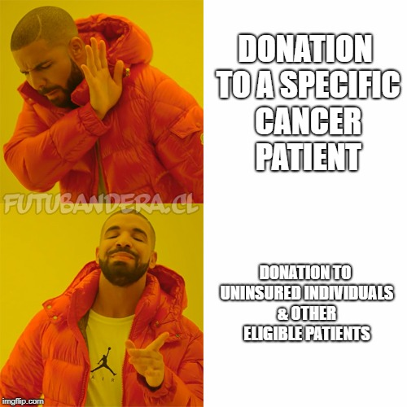
1.4.11 Conditions regarding the return and/or reuse of pharmaceutical products, preparations, bulk drug substances/excipients, and devices –
Cancer or Other Repository Programs - 61N-1.026 Cancer Drug Donation Program
Requirements for Participant Facilities (continued)
Dispensing
Cancer drugs and supplies shall be dispensed by a licensed pharmacist, whether or not employed by or under contract with a participant facility
The pharmacist shall inspect the donated cancer drugs and supplies for adulteration, misbranding, mislabeling, and the date of expiration before dispensing
  Cancer drugs or supplies that are tampered with, expired, adulterated, mislabeled or misbranded may not be dispensed
Before a cancer drug or supply may be dispensed to a recipient, the recipient shall sign a cancer drug donation program Recipient Record Form and shall be notified, both orally and in writing, that the cancer drug or supply may have been previously dispensed
Cancer drugs and supplies shall be dispensed only to recipients who meet the following eligibility requirements:
  Individuals who are uninsured
  All other individuals who are otherwise eligible to receive cancer drugs or supplies from the cancer drug donation program
Cancer drugs or supplies may not be donated to a specific cancer patient

Slide 65

1.4.11 Conditions regarding the return and/or reuse of pharmaceutical products, preparations, bulk drug substances/excipients, and devices –
Cancer or Other Repository Programs - 61N-1.026 Cancer Drug Donation Program
Requirements for Participant Facilities (continued)
Recordkeeping requirements
Donor Records, Recipient Records, and Destruction Records shall be maintained at least 3 years by the participant facility
For each drug or supply destroyed the record shall include all of the following information:
    The date of destruction
    The name, strength and quantity of the cancer drug destroyed
    The name of the person or firm that destroyed the drug
    The source of the drugs or supplies destroyed
Dispensing Fees
A cancer drug donation program participant facility may charge the recipient of the drug or supply a handling fee of no more than 300% of the Medicaid dispensing fee or no more than $15.00, whichever is less, for each cancer drug or supply dispensed
Keep records 3 years

Slide 66


1.4.11 Conditions regarding the return and/or reuse of pharmaceutical products, preparations, bulk drug substances/excipients, and devices –
Cancer or Other Repository Programs - 61N-1.026 Cancer Drug Donation Program
Cancer drugs – to be donated must meet ALL of the following requirements:
Donation is accompanied by a completed cancer drug donation program Donation Record signed by the person making the donation or that person’s authorized representative
The drug’s expiration date is at least 6 months later than the date that the drug was donated and its tamper resistant packaging is intact
The drug is in its original, unopened, sealed, tamper-evident unit dose packaging that includes the drug’s lot number and expiration date. Single-unit dose drugs may be accepted if the single-unit dose packaging is unopened
Cancer drugs billed to and paid for by Medicaid in long-term care facilities are not eligible for donation unless not reimbursable by Medicaid
Cancer supplies – to be donated must meet ALL of the following requirements:
The supplies have not been tampered with or mislabeled; the supplies are in their original, unopened, sealed packaging
The donation is accompanied by a completed cancer drug donation program Donation Record that is signed by the person making the donation or that person’s authorized representative
Drugs that CANNOT be donated:
Schedule II, Schedule III, Schedule IV or Schedule V controlled substances
Drugs and supplies that do not meet the eligibility criteria above
Drugs that expire less than 6 months after the date of donation
Except Schedule I…? LOL!
nope nope nope!

Slide 67
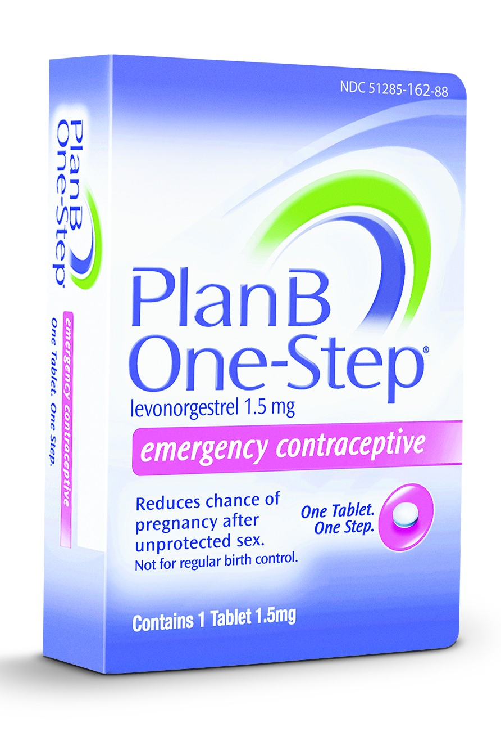
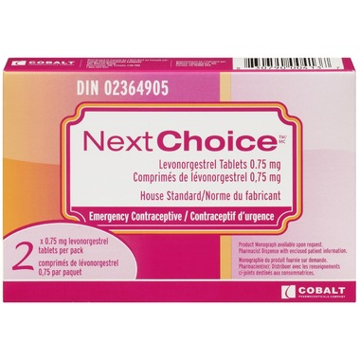
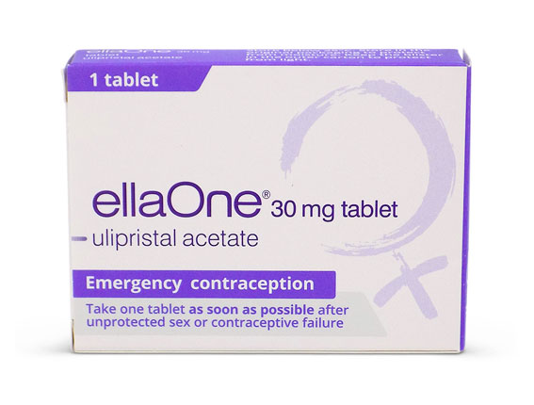
1.6.3 Requirements for the distribution and/or dispensing of poisons, restricted, non-prescription pharmaceutical products, and other restricted materials or devices – Emergency Contraception
In Florida, there are no specific laws related to emergency contraception (other than the conscience clause)
  Your store may have a specific policy
Emergency contraception
Plan B One-Step, Next Choice
  Available over-the-counter in the family planning aisle
  No prescription or ID check required and no age restriction
  No requirement to talk to partner
ellaOne is a type of emergency contraception that requires a prescription
Other states have laws requiring hospitals to provide information about emergency contraception or initiation of emergency contraception for survivors of sexual assault
OTC
RX ONLY

Slide 68

1.6.3 Requirements for the distribution and/or dispensing of POISONS
Only pharmacists can sell poisons; must label the box/vessel/paper in which it is contained
with the name of the article, the word “POISON” and the name and place of business of the seller; manufacturers can also make and sell at wholesale any of the poisons listed and need to follow
the labeling requirements pharmacists are held to
859.04 Provisions concerning poisons
It is unlawful for any person not a registered pharmacist to retail any poisons enumerated below:
  Arsenic and all its preparations, corrosive sublimate, white and red precipitate, biniodide of mercury, cyanide of potassium, hydrocyanic acid, strychnine, and all other poisonous vegetable alkaloids and their salts, and the essential oil of almonds, opium, and its preparations of opium containing less than two grains to the ounce, aconite, belladonna, colchicum, conium, nux vomica, henbane, savin, ergot, cotton root, cantharides, creosote, veratrum digitalis, and their pharmaceutical preparations, croton oil, chloroform, chloral hydrate, sulphate of zinc, mineral acids, carbolic and oxalic acids
The pharmacist shall label the box, vessel, or paper in which said poison is contained with the name of the article, the word “poison,” and the name and place of business of the seller.
No person shall deliver or sell any poisons enumerated above unless when questioned it’s known the purchaser is aware of its poisonous character and represents it is to be used for a legitimate purpose.
The provisions of this section shall not apply to the dispensing of poisons in not unusual quantities or doses upon the prescriptions of practitioners of medicine.
Any violation of this section shall render the principal of the store guilty of a misdemeanor of the second degree.
  However, this section shall not apply to manufacturers making and selling at wholesale any of the above poisons. Each box, vessel, or paper in which said poison is contained shall be labeled with the name of the article, the word “poison,” and the name and place of business of the seller.
859.02 Selling certain poisons by registered pharmacists and others —Any violation of the law, relative to sale of poisons, not specially provided for, shall constitute a misdemeanor of the second degree ($500 fine)

Slide 69

1.8 Requirements for handling hazardous materials such as described in USP <800>
- USP 800 Generally
What is USP 800?
It is the practice and quality standards for the handling of hazardous drugs
Promotes patient safety, workers, and the environment
Covers all hazardous drugs throughout the process: receipt, storage, compounding, dispensing, administration, and disposal of sterile and nonsterile products
Who does USP 800 apply to?
Healthcare personnel who handle hazardous drugs and could be exposed
  Pharmacists & pharmacy technicians and others
  When you work in a hospital, they make you take all these mandatory computer training modules on handling of hazardous substances

Slide 70

1.8 Requirements for handling hazardous materials such as described in USP <800>
- USP 800 Generally
USP 800 standards must be incorporated into the occupational safety plan for hospitals and other entities that handle hazardous drugs
A list of hazardous drugs (yes, you guessed it – we shall memorize this long list)
Facility and engineering controls
Competency of personnel
Safe work practices
Proper use of Personal Protective Equipment
Policies for hazardous drug waste segregation and disposal

Slide 71
1.8 Requirements for handling hazardous materials such as described in USP <800>
- USP 800 Hazardous Drugs
List of Hazardous Drugs
The National Institute for Occupational Safety and Health (NIOSH) maintains the list of antineoplastic drugs and other hazardous drugs (HD) used in healthcare
Hospitals and other entities handling HDs must include any drug on the NIOSH list that they handle at their site
The list must be reviewed every 12 months and if new agents or dosage forms are used, they should be reviewed against the entity’s list
Criteria on NIOSH list to identify HDs
Entity must use this criteria to identify HDs on the market that are not yet on the list or investigational drugs that would qualify
If there is not enough information on the drug to make a determination, consider it hazardous until more information is discovered

Slide 72
1.8 Requirements for handling hazardous materials such as described in USP <800>
- USP 800 Hazardous Drugs
List of Hazardous Drugs
•Most current update from 2016
•Most are antineoplastic drugs, but the others that are not can produce physiological effects in small quantities or cause irreversible effects
•Safe-handling of an HD, engineering controls, and personal protective equipment (PPE) used with an HD depends on its dosage form and the activity of the drug
The NIOSH List divides the drugs into three groups
•Group 1: Antineoplastic drugs
•Many of these drugs may also pose a reproductive risk for susceptible populations
•Group 2: Non-antineoplastic drugs that meet one or more of the NIOSH criteria for a hazardous drug
•Some of these drugs may also pose a reproductive risk for susceptible populations
•Group 3: Non-antineoplastic drugs that primarily have adverse reproductive effects
Drugs that primarily pose a reproductive risk to men and women who are actively trying to conceive and women who are pregnant or breastfeeding because some of these drugs may be present in breast milk

Slide 73
Upcoming 2018 Changes to NIOSH List Criteria (Not Approved Yet as of 4/2/18)
For the proposed 2018 list which is under review right now, NIOSH presents the policy for how drugs are assigned to the 3 hazardous drug classifications using a new peer reviewed 5 Category system based on evidence of the hazard:
Category 1—Special Handling Information
    Drugs listed in Category 1 list special handling information listed within the manufacturers package insert. Examples would include compounding in biological safety cabinets
Category 2—Insufficient Toxicity Information Available to Meet NIOSH Definition of Hazardous Drug
Category 3—Available Information Shows a Toxic Effect that Does Not Meet the NIOSH Definition of a Hazardous Drug
Category 4—Available Toxicity Information Does Not Demonstrate or Support a Determination that the Drug Meets the NIOSH Definition of a Hazardous Drug
    Drugs listed in Categories 2 through 4 classifies studies, alerts and lack of evidence to support inclusion to the NIOSH hazardous drug list
Category 5—Available Toxicity Information Demonstrates or Supports a Determination that the Drug Meets the NIOSH Definition of a Hazardous Drug
    Drugs listed in Category 5 list drugs with confirming evidence to support inclusion on the NIOSH hazardous drug list
https://visanteinc.com/2018/02/2018-niosh-proposed-hazardous-drug-list-out-for-comment/

Slide 74
1.8 Requirements for handling hazardous materials such as described in USP <800>
Handling Hazardous Materials Generally
General Recommendations for handling HDs
All HDs regardless of formulation should be labeled as such to prevent improper handling
Most reproductive risks apply to women, but some can reduce fertility or sperm count in men or can affect both men and women
Some workers may not be a susceptible population because of their age or infertility
NIOSH categorizes the drugs based on their criteria, but they don’t perform risk assessments or propose exposure limits
NIOSH does provide guidance for personal protective equipment and ventilated engineering controls for various typical scenarios in which a drug may be handled in a healthcare setting, but it doesn’t cover all possible situations

Slide 75
1.8 Requirements for handling hazardous materials such as described in USP <800>
Handling Hazardous Materials – Formulation Specifics
General Recommendations for handling HDs – formulations
Some drugs that are in coated tablets or capsules may not pose a direct risk until they are crushed or solutions are made from them outside of a ventilated cabinet
Uncoated tablets may pose a risk of exposure from dust to skin contact or inhalation when the tablets are counted
Tablet and capsules of HDs should not be placed in automated counting machines that may cause powdered contaminants to enter the work area
Counting and pouring of HDs should be done carefully with clean equipment dedicated only to use with these drugs
Crushing tablets or opening capsules should be avoided and liquid formulations should be used whenever possible
When compounding HDs (crushing, dissolving, or preparing a solution or ointment), workers should wear nonpermeable gowns and double gloves
Guidelines for safe compounding, administration, and disposal of HDs have been developed by several groups (NIOSH, ASHP, ONS, USP, OSHA)

Slide 76
1.8 Requirements for handling hazardous materials such as described in USP <800>
Hazardous Drugs Definition
Defining HDs
Hazardous drugs include those used for cancer chemotherapy, antiviral drugs, hormones, some bioengineered drugs, and other miscellaneous drugs
NIOSH’s definition is based off of the definition developed by ASHP in 1990
Accordingly, the definition may not completely describe potential toxicity of newer agents
Whenever healthcare workers work with HDs, they should follow:
NIOSH recommendations
Any recommendations from the manufacturer's Safety Data Sheet [SDS, formerly called a Material Safety Data Sheet (MSDS)]
Recommendations from the drug package insert (DPI)

Slide 77
1.8 Requirements for handling hazardous materials such as described in USP <800>
Hazardous Drugs Definition
NIOSH Definition of Hazardous Drugs (revised from ASHP’s version)
Drugs considered hazardous include those that exhibit one or more of the following six characteristics in humans and animals:
Carcinogenicity
Teratogenicity or other developmental toxicity
Reproductive toxicity
Organ toxicity at low doses
Genotoxicity
Structure and toxicity profiles of new drugs that mimic existing drugs determined hazardous by the above criteria
Notes:
Know six for exam

Slide 78
1.8 Requirements for handling hazardous materials such as described in USP <800>
Hazardous Drugs Definition
Determining if Drugs are Hazardous – more details under the definition
•Reproductive and Developmental Toxicity
•NIOSH looks at whether the dose for animal testing where adverse effects [reproductive & developmental toxicity, effects on the mother (maternal toxicity), effects on the fetus absent maternal toxicity] are observed is at near, at, or below the maximum recommended human dose (MRHD)
•If the dose to obtain an adverse effect is many times the MRHD, they usually won’t consider the drug hazardous with regards to this aspect
•Many of the Pregnancy Category X drugs are listed, as well as Category D
•Available human data is also considered
•Carcinogenicity
•Looks for tumors in more than one species and sex
•Tumors in multiple organs and for tumors that are not rodent-specific
•Consider available human data
•Genotoxicity
•Considers adverse outcomes for in vivo and in vitro testing, but gives more weight to in vivo testing or if several in vitro tests result in adverse outcomes
•Organ Toxicity
•If organ toxicity occurs at the low dose criterion dose (benchmark doses: 10mg/day or a dose of 1mg/kg per day in lab animals)
•Other
•Drugs with safe-handling guidelines from the manufacturer are automatically put on the list because the manufacturer has determined their properties warrant special handling

Slide 79
1.8 Requirements for handling hazardous materials such as described in USP <800>
List of Hazardous Drugs
•How Organizations Should Make their Own List of HDs
•Employers must comply with the OSHA Hazard Communication Requirements
•Federal law [29 CFR 1910.1200], the OSHA hazard communication standard, requires employers to develop a hazard communication program appropriate for their unique workplaces
•Link to 29 CFR 1910.1200: https://www.law.cornell.edu/cfr/text/29/1910.120
•To be in compliance with OSHA, the program must identify of all hazardous chemicals a worker may encounter in the facility and must develop a list of those hazardous chemicals as part of the written hazardous communication program and informing workers where that list can be obtained
•The criteria OSHA uses to identify hazardous chemicals, including hazardous drugs, are provided in that standard/law. Institutions may wish to compare their lists to the listing in this document or on the NIOSH website.
•Facilities must assess each new drug that enters the workplace to determine if it should be included and they must assess their list when new data is available; if no toxicological data are available, if the mechanism of action is concerning, treat it as a hazardous drug until information becomes available
•Need to make list specific to drugs used at the facility

Slide 80
1.8 Requirements for handling hazardous materials such as described in USP <800>
How Organizations Should Make their Own List of HDs
•Check NIOSH’s List of Hazardous Drugs
•Current list consists of 2014 NIOSH update and the 2016 NIOSH update added 34 drugs to the list
•The OSHA hazard communication standard requires a written program including a list of chemicals that meet the Hazard Communication definitions for hazardous, labelling, and employee training
•Applies to healthcare professionals who provide direct patient care and to those who support patient care by participating in product acquisition, storage, transportation, housekeeping, and waste disposal.
•Institutions may want to adopt this list or compare theirs with the list on the NIOSH website
•`If a drug is not on the list, check the available literature for mentions of carcinogenicity, genotoxicity, teratogenicity or reproductive or developmental toxicity, the SDS from the manufacturer, the DPI (safe-handling warnings), and other institutions who may be using the drug
•Check if drug meets one or more of the criteria for HDs in the NIOSH definition
•If it meets one or more, it can be classified as hazardous
Where to Find Information on Drug Toxicity
Safety Data Sheets (SDS)
Product labeling approved by the FDA (DPI)
International Agency for Research on Cancer (IARC): http://www.iarc.fr
DrugBank: http://www.drugbank.ca/
DailyMed: http://dailymed.nlm.nih.gov/dailymed/
Special health warnings from drug manufacturers, FDA, and other professional groups and organizations
Reports and case studies published in medical and other healthcare profession journals
Evidence-based recommendations from other facilities that meet the criteria defining hazardous drugs

Slide 81
1.8 Requirements for handling hazardous materials such as described in USP <800> - GROUP 1 LIST OF HDs
NIOSH List of Antineoplastic and Other Hazardous Drugs in Healthcare Settings, 2016
(Three Lists because there are three Groups)
Group 1 drugs: Antineoplastic drugs
  Meet one or more of the NIOSH criteria for a hazardous drug
  Many of these drugs are cytotoxic
  Majority are hazardous to males or females who are actively trying to conceive, women who are pregnant or may become pregnant, and women who are breastfeeding, because they may be present in breast milk
Group 1 drugs are an occupational hazard to healthcare workers and should always be handled with use of recommended engineering controls and personal protective equipment (PPE), regardless of their formulation (IV [intravenous], SC [subcutaneous], topical, tablet, or capsule).
Unopened, intact tablets and capsules may not pose the same degree of occupational exposure risk as injectable drugs, which usually require extensive preparation
Cutting, crushing, or otherwise manipulating tablets and capsules will increase the risk of exposure to workers
The manufacturer’s safe-handling guidance (MSHG) is typically in Section 16 of the drug package insert (DPI)

Slide 82
1.8 Requirements for handling hazardous materials such as described in USP <800> - GROUP 2 LIST OF HDs
NIOSH List of Antineoplastic and Other Hazardous Drugs in Healthcare Settings, 2016
(Three Lists because there are three Groups)
Group 2 drugs: Non-antineoplastic drugs that meet one or more of the NIOSH criteria for a hazardous drug
  Meet one or more of the NIOSH criteria for a hazardous drug
  Some of these drugs may represent an occupational hazard to males or females who are actively trying to conceive, women who are pregnant or may become pregnant, and women who are breastfeeding, because they may be present in breast milk
Unopened, intact tablets and capsules may not pose the same degree of occupational exposure risk as injectable drugs, which usually require extensive preparation
Cutting, crushing, or otherwise manipulating tablets and capsules will increase the risk of exposure to workers
The manufacturer’s safe-handling guidance (MSHG) is typically in Section 16 of the drug package insert

Slide 83
1.8 Requirements for handling hazardous materials such as described in USP <800> - GROUP 3 LIST OF HDs
NIOSH List of Antineoplastic and Other Hazardous Drugs in Healthcare Settings, 2016
(Three Lists because there are three Groups)
Group 3 drugs: Non-antineoplastic drugs that primarily have adverse reproductive effects
  Primarily meet the NIOSH criteria for reproductive hazards
  They represent a potential occupational hazard to males or females who are actively trying to conceive, women who are pregnant or may become pregnant, and women who are breast feeding, as they may be present in breast milk
Unopened, intact tablets and capsules may not pose the same degree of occupational risk as injectable drugs that usually require extensive preparation
Cutting, crushing, or otherwise manipulating tablets and capsules will increase the risk of exposure to workers
The manufacturer’s safe-handling guidance (MSHG) is typically in Section 16 of the drug package insert

Slide 84
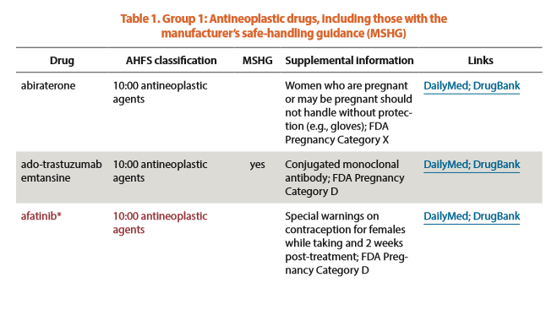
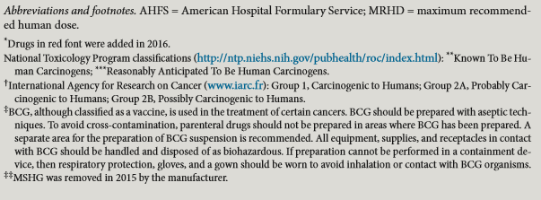
1.8 Requirements for handling hazardous materials such as described in USP <800> - GROUP 1 LIST OF HDs
NIOSH List of Antineoplastic and Other Hazardous Drugs in Healthcare Settings, 2016

Slide 85
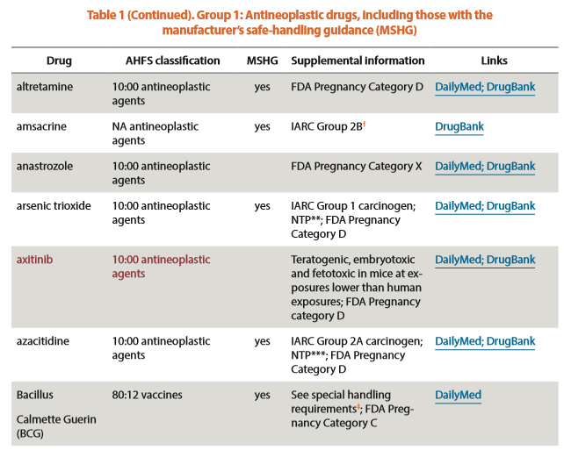
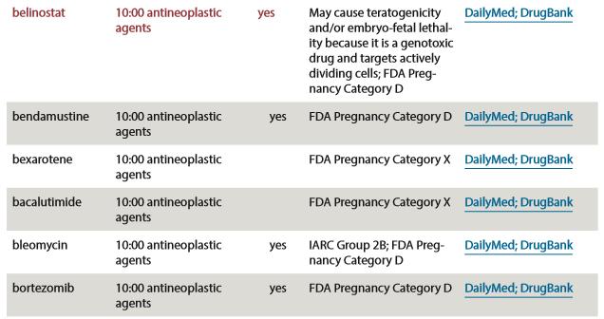
1.8 Requirements for handling hazardous materials such as described in USP <800> - GROUP 1 LIST OF HDs
NIOSH List of Antineoplastic and Other Hazardous Drugs in Healthcare Settings, 2016

Slide 86
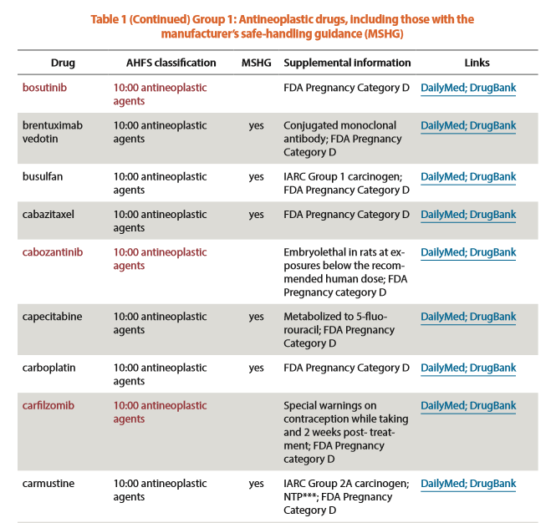
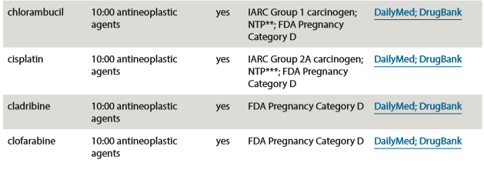
1.8 Requirements for handling hazardous materials such as described in USP <800> - GROUP 1 LIST OF HDs
NIOSH List of Antineoplastic and Other Hazardous Drugs in Healthcare Settings, 2016

Slide 87
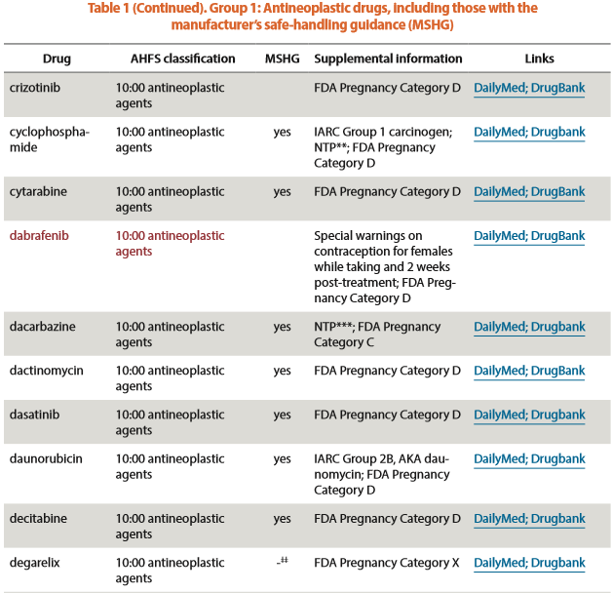
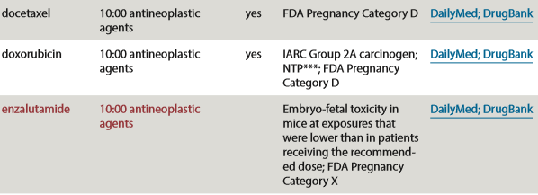
1.8 Requirements for handling hazardous materials such as described in USP <800> - GROUP 1 LIST OF HDs
NIOSH List of Antineoplastic and Other Hazardous Drugs in Healthcare Settings, 2016

Slide 88
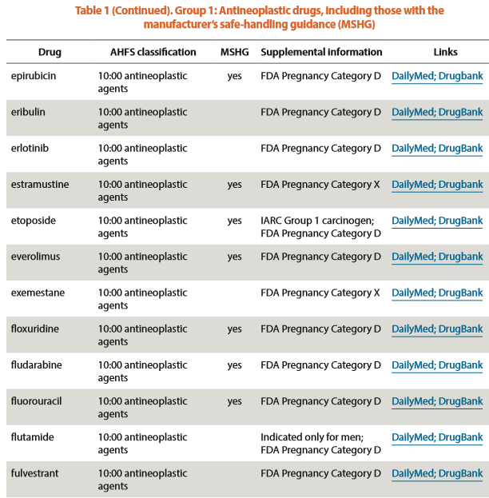
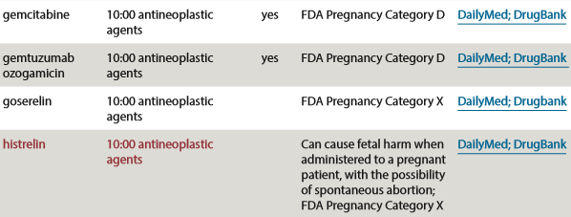
1.8 Requirements for handling hazardous materials such as described in USP <800> - GROUP 1 LIST OF HDs
NIOSH List of Antineoplastic and Other Hazardous Drugs in Healthcare Settings, 2016

Slide 89
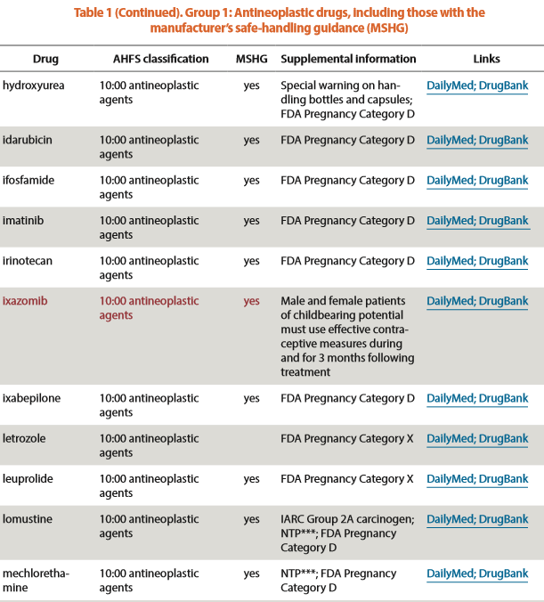
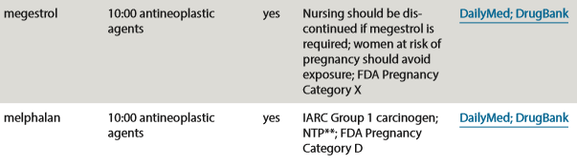
1.8 Requirements for handling hazardous materials such as described in USP <800> - GROUP 1 LIST OF HDs
NIOSH List of Antineoplastic and Other Hazardous Drugs in Healthcare Settings, 2016

Slide 90
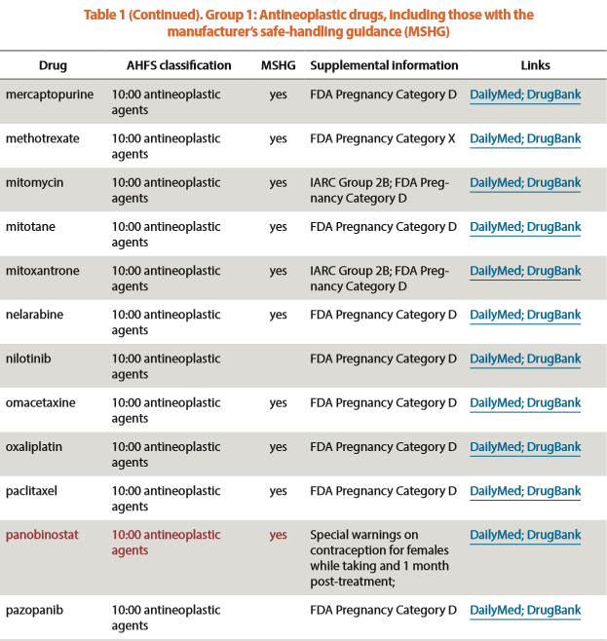
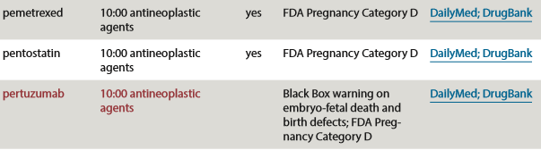
1.8 Requirements for handling hazardous materials such as described in USP <800> -
GROUP 1 LIST OF HDs
NIOSH List of Antineoplastic and Other Hazardous Drugs in Healthcare Settings, 2016

Slide 91
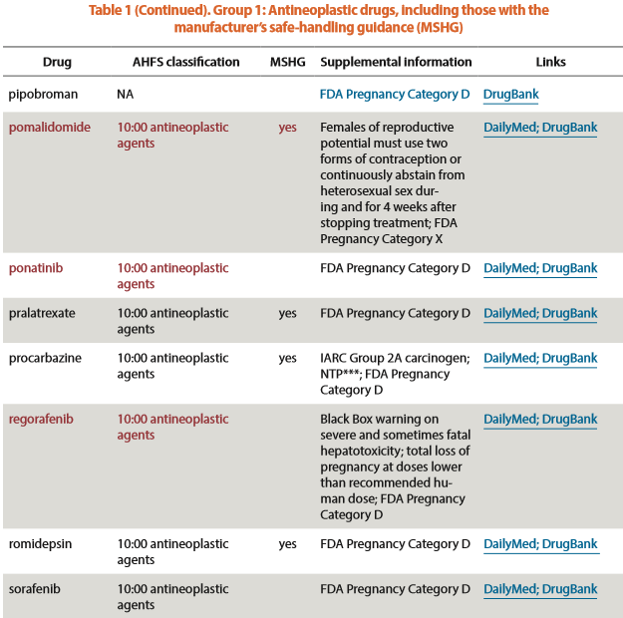
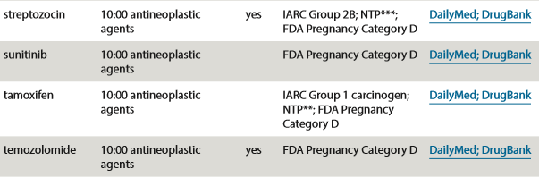
1.8 Requirements for handling hazardous materials such as described in USP <800> -
GROUP 1 LIST OF HDs
NIOSH List of Antineoplastic and Other Hazardous Drugs in Healthcare Settings, 2016

Slide 92
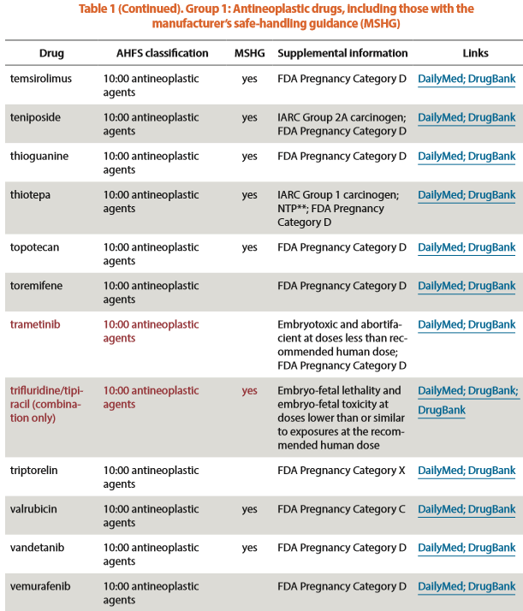
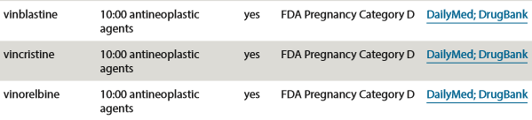
1.8 Requirements for handling hazardous materials such as described in USP <800> - GROUP 1 LIST OF HDs
NIOSH List of Antineoplastic and Other Hazardous Drugs in Healthcare Settings, 2016

Slide 93
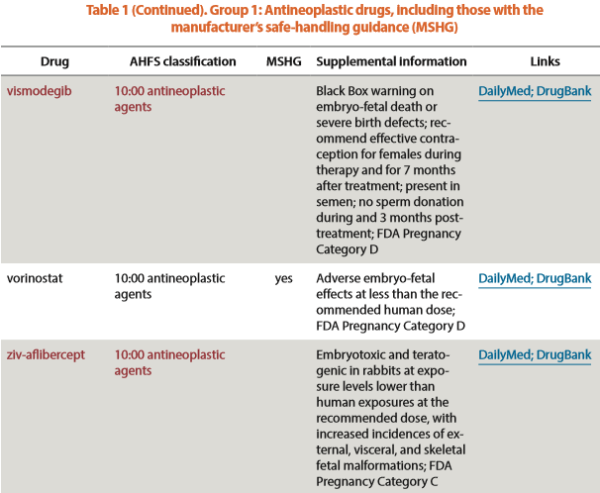
1.8 Requirements for handling hazardous materials such as described in USP <800> - GROUP 1 LIST OF HDs
NIOSH List of Antineoplastic and Other Hazardous Drugs in Healthcare Settings, 2016

Slide 94
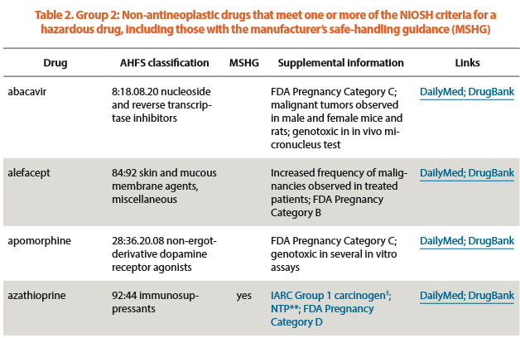
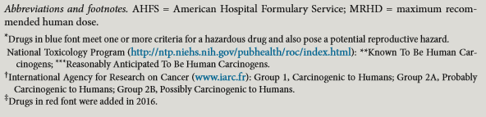
1.8 Requirements for handling hazardous materials such as described in USP <800> - GROUP 2 LIST OF HDs
NIOSH List of Antineoplastic and Other Hazardous Drugs in Healthcare Settings, 2016

Slide 95
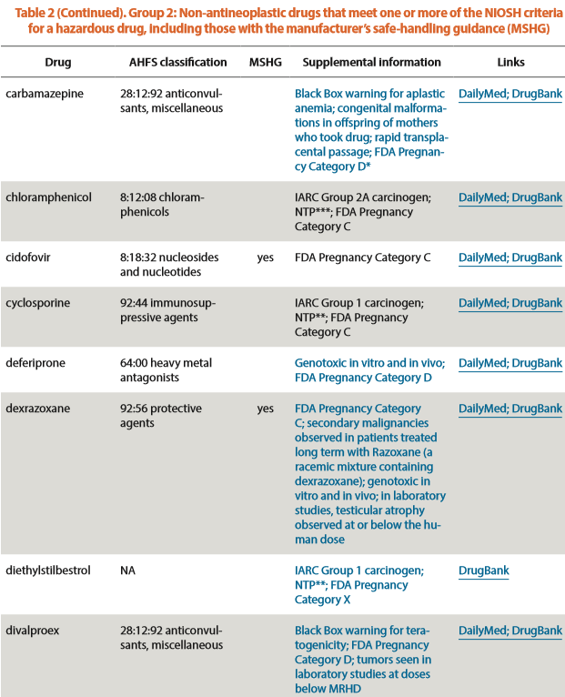
1.8 Requirements for handling hazardous materials such as described in USP <800> - GROUP 2 LIST OF HDs
NIOSH List of Antineoplastic and Other Hazardous Drugs in Healthcare Settings, 2016

Slide 96
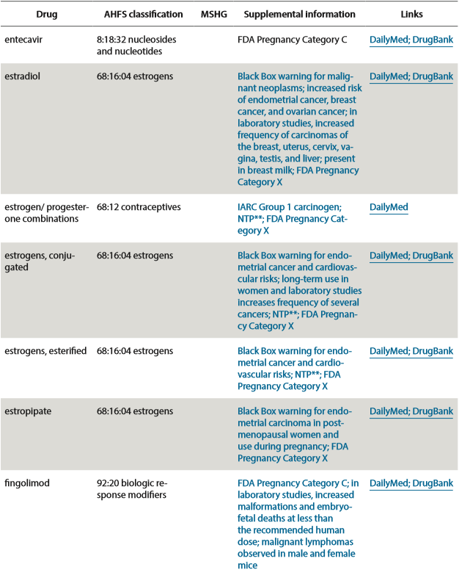
1.8 Requirements for handling hazardous materials such as described in USP <800> -
GROUP 2 LIST OF HDs
NIOSH List of Antineoplastic and Other Hazardous Drugs in Healthcare Settings, 2016

Slide 97
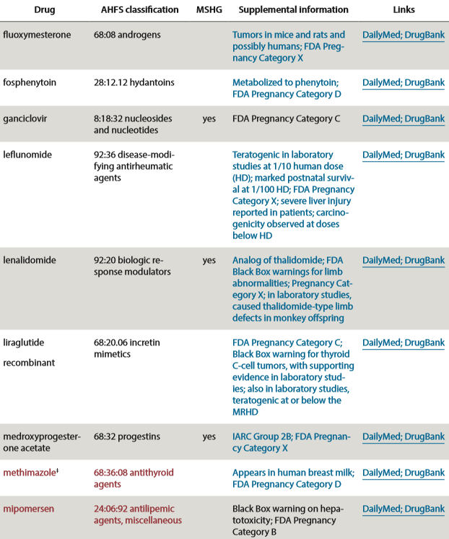
1.8 Requirements for handling hazardous materials such as described in USP <800> -
GROUP 2 LIST OF HDs
NIOSH List of Antineoplastic and Other Hazardous Drugs in Healthcare Settings, 2016

Slide 98
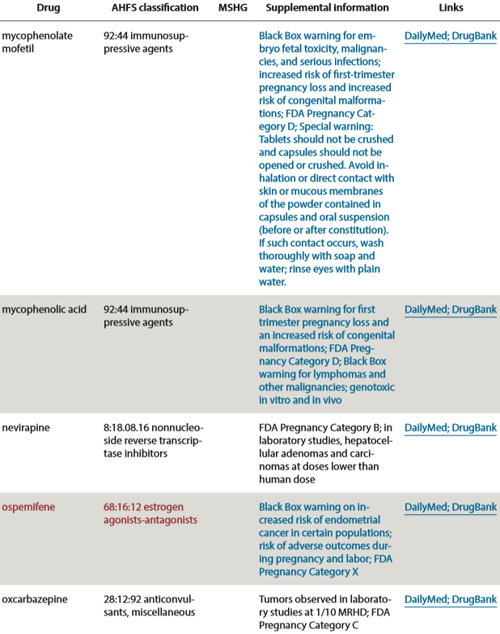
1.8 Requirements for handling hazardous materials such as described in USP <800> -
GROUP 2 LIST OF HDs
NIOSH List of Antineoplastic and Other Hazardous Drugs in Healthcare Settings, 2016

Slide 99
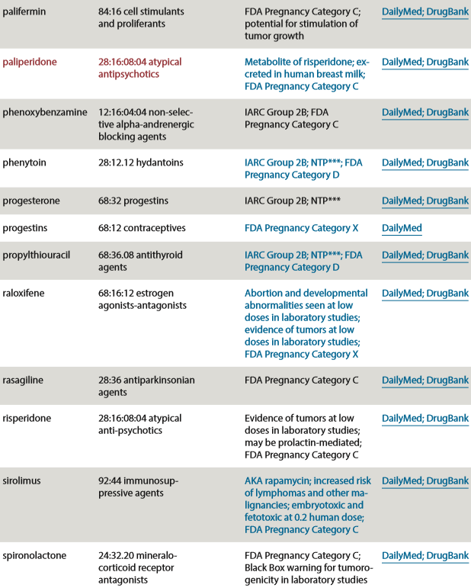
1.8 Requirements for handling hazardous materials such as described in USP <800> -
GROUP 2 LIST OF HDs
NIOSH List of Antineoplastic and Other Hazardous Drugs in Healthcare Settings, 2016

Slide 100
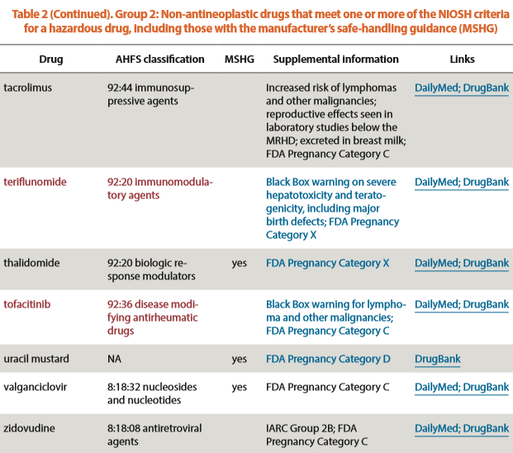
1.8 Requirements for handling hazardous materials such as described in USP <800> -
GROUP 2 LIST OF HDs
NIOSH List of Antineoplastic and Other Hazardous Drugs in Healthcare Settings, 2016

Slide 101
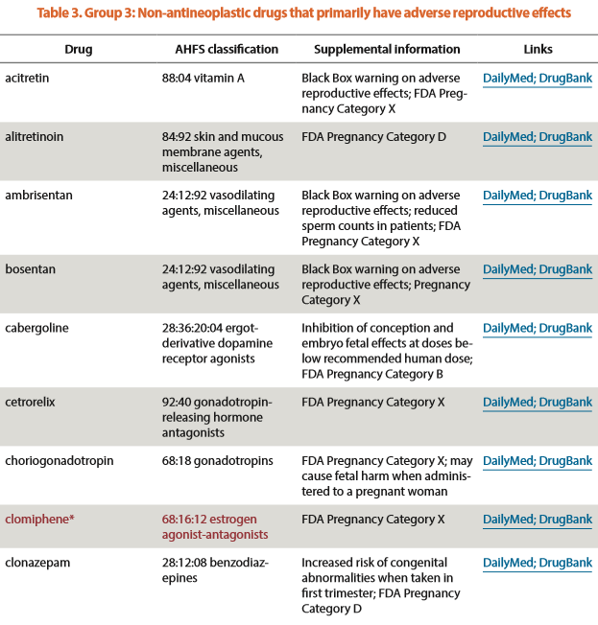
1.8 Requirements for handling hazardous materials such as described in USP <800> -
GROUP 3 LIST OF HDs
NIOSH List of Antineoplastic and Other Hazardous Drugs in Healthcare Settings, 2016

Slide 102
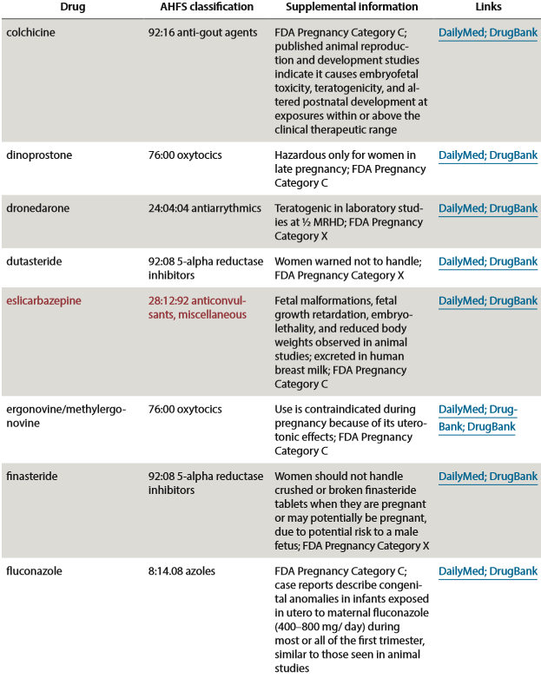
1.8 Requirements for handling hazardous materials such as described in USP <800> -
GROUP 3 LIST OF HDs
NIOSH List of Antineoplastic and Other Hazardous Drugs in Healthcare Settings, 2016

Slide 103
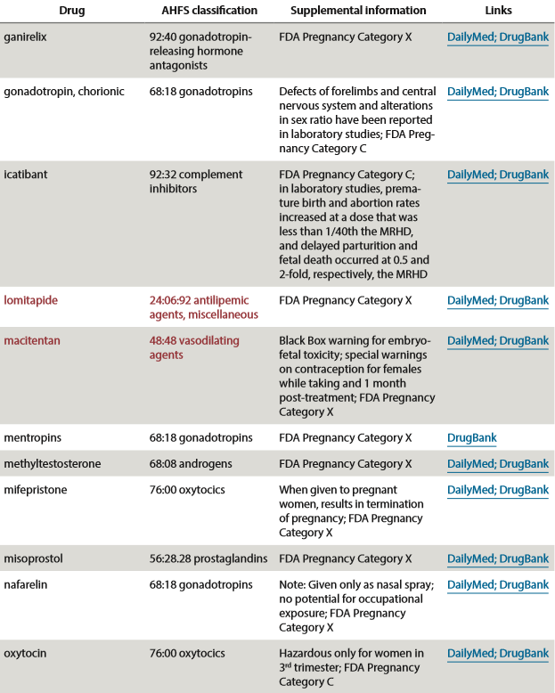
1.8 Requirements for handling hazardous materials such as described in USP <800> -
GROUP 3 LIST OF HDs
NIOSH List of Antineoplastic and Other Hazardous Drugs in Healthcare Settings, 2016

Slide 104
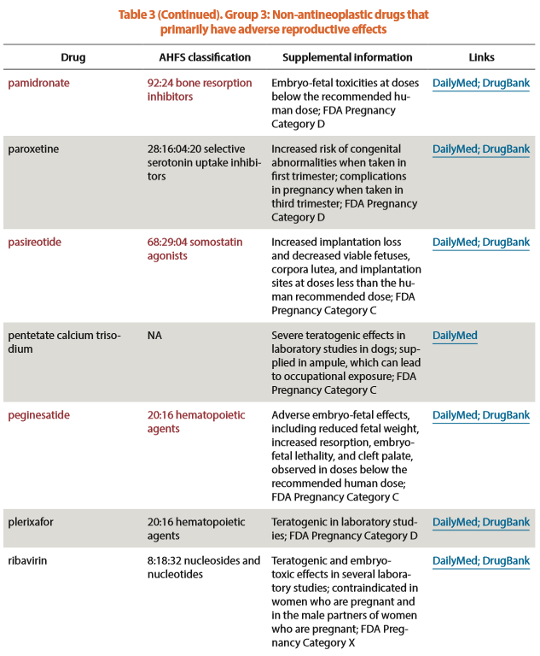
1.8 Requirements for handling hazardous materials such as described in USP <800> -
GROUP 3 LIST OF HDs
NIOSH List of Antineoplastic and Other Hazardous Drugs in Healthcare Settings, 2016

Slide 105
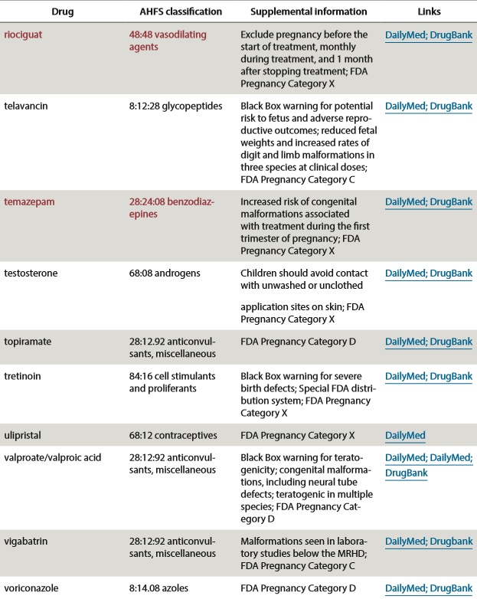
1.8 Requirements for handling hazardous materials such as described in USP <800> -
GROUP 3 LIST OF HDs
NIOSH List of Antineoplastic and Other Hazardous Drugs in Healthcare Settings, 2016

Slide 106
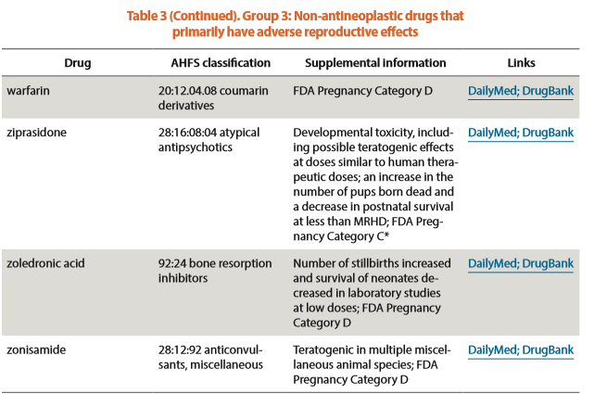
1.8 Requirements for handling hazardous materials such as described in USP <800> -
GROUP 3 LIST OF HDs
NIOSH List of Antineoplastic and Other Hazardous Drugs in Healthcare Settings, 2016

Slide 107
1.8 Requirements for handling hazardous materials such as described in USP <800>
1.8.1 Requirements for appropriate disposal of hazardous materials
Disposal
  All personnel who perform routine custodial waste removal and cleaning activities in HD handling areas must be trained in appropriate procedures to protect themselves and the environment to prevent HD contamination
  Disposal of all HD waste, including, but not limited to, unused HDs and trace-contaminated PPE and other materials, must comply with all applicable federal, state, and local regulations

Slide 108
1.8 Requirements for handling hazardous materials such as described in USP <800>
1.8.2 Requirements for training regarding hazardous materials
PERSONNEL TRAINING
  All personnel who handle HDs must be trained based on their job functions (e.g., in the receipt, storage, compounding, repackaging, dispensing, administering, and disposing of HDs)
  Training must occur before the employee independently handles HDs
  The effectiveness of training for HD handling competencies must be demonstrated by each employee
  Personnel competency must be reassessed at least every 12 months
  Personnel must be trained prior to the introduction of a new HD or new equipment and prior to a new or significant change in process or SOP
All training and competency assessment must be documented.
  The training must include at least the following:
    Overview of entity's list of HDs and their risks
    Review of the entity's SOPs related to handling of HDs
    Proper use of PPE
    Proper use of equipment and devices (e.g., engineering controls)
    Response to known or suspected HD exposure
    Spill management
    Proper disposal of HDs and trace-contaminated materials

Slide 109
1.8 Requirements for handling hazardous materials such as described in USP <800>
1.8.2 Requirements for training regarding hazardous materials –
Material Safety Data Sheets (now called Safety Data Sheets)
The Hazard Communication Standard (HCS) requires chemical manufacturers, distributors, or importers to provide Safety Data Sheets (SDSs) (formerly MSDSs or Material Safety Data Sheets) for each hazardous chemical to downstream users to communicate information on these hazards
SDSs are required to be presented in a consistent user-friendly, 16-section format
The SDS includes information such as the properties of each chemical; the physical, health, and environmental health hazards; protective measures; and safety precautions for handling, storing, and transporting the chemical.
The information contained in the SDS must be in English (although it may be in other languages as well).
In addition, OSHA requires that SDS preparers provide specific minimum information as detailed in Appendix D of 29 CFR 1910.1200. The SDS preparers may also include additional information in various section(s).
  Sections 1 through 8 contain general information about the chemical, identification, hazards, composition, safe handling practices, and emergency control measures (e.g., fire fighting). This information should be helpful to those that need to get the information quickly.
  Sections 9 through 11 and 16 contain other technical and scientific information, such as physical and chemical properties, stability and reactivity information, toxicological information, exposure control information, and other information including the date of preparation or last revision. The SDS must also state that no applicable information was found when the preparer does not find relevant information for any required element.
  The SDS must also contain Sections 12 through 15, to be consistent with the UN Globally Harmonized System of Classification and Labeling of Chemicals (GHS), but OSHA will not enforce the content of these sections because they concern matters handled by other agencies.
https://www.osha.gov/Publications/OSHA3514.html

Slide 110
1.8 Requirements for handling hazardous materials such as described in USP <800>
1.8.2 Requirements for training regarding hazardous materials -
Material Safety Data Sheets (now called Safety Data Sheets)
Safety Data Sheets - 16 Section Format
Section 1: Identification
Section 2: Hazard Identification
Section 3: Composition/ Information on Ingredients
Section 4: First-Aid Measures
Section 5: Fire-Fighting Measures
Section 6: Accidental Release Measures
Section 7: Handling and Storage
Section 8: Exposure Controls/Personal Protection
Section 9: Physical and Chemical Properties
Section 10: Stability and Reactivity
Section 11: Toxicological Information
Section 12: Ecological Information (non mandatory)
Section 13: Disposal Considerations (non mandatory)
Section 14: Transport Information (non mandatory)
Section 15: Regulatory Information (non mandatory)
Section 16: Other Information
https://www.osha.gov/Publications/OSHA3514.html

Slide 111
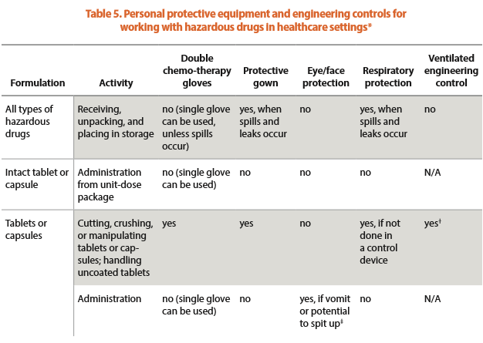

1.8 Requirements for handling hazardous materials such as described in USP <800> -
1.8.3 Environmental controls addressing the proper storage, handling, and disposal of hazardous materials -
Ventilation controls, personal protective equipment

Slide 112

1.8 Requirements for handling hazardous materials such as described in USP <800> -
1.8.3 Environmental controls addressing the proper storage, handling, and disposal of hazardous materials -
Ventilation controls, personal protective equipment

Slide 113

1.8 Requirements for handling hazardous materials such as described in USP <800> -
1.8.3 Environmental controls addressing the proper storage, handling, and disposal of hazardous materials -
Ventilation controls, personal protective equipment

Slide 114
1.8 Requirements for handling hazardous materials such as described in USP <800> -
1.8.3 Environmental controls addressing the proper storage, handling, and disposal of hazardous materials -
Personal Protective Equipment
Personal Protective Equipment (PPE) provides worker protection to reduce exposure, may be required to handle the HDs when treating a patient or cleaning a spill.
The NIOSH list of antineoplastic and other HDs provides general guidance on PPE for possible scenarios that may be encountered in healthcare settings
Disposable PPE must not be re-used
Reusable PPE must be decontaminated and cleaned after use
Gowns, head, hair, shoe covers, and two pairs of chemotherapy gloves are required for compounding sterile and nonsterile HDs
Two pairs of chemotherapy gloves are required for administering antineoplastic HDs
Gowns shown to resist permeability by HDs are required when administering injectable antineoplastic HDs

Slide 115
1.8 Requirements for handling hazardous materials such as described in USP <800> -
1.8.3 Environmental controls addressing the proper storage, handling, and disposal of hazardous materials -
Personal Protective Equipment
Personal Protective Equipment (PPE) provides worker protection to reduce exposure, may be required to handle the HDs when treating a patient or cleaning a spill.
For all other activities, the entity's SOP must describe the appropriate PPE to be worn based on its occupational safety plan and assessment of risk (if used)
The entity must develop SOPs for PPE based on the risk of exposure (see Types of Exposure) and activities performed.
Appropriate PPE must be worn when handling HDs including during:
  Receipt
  Storage
  Transport
  Compounding (sterile and nonsterile)
  Administration
  Deactivation/decontamination, cleaning, and disinfecting
  Spill control
  Waste disposal

Slide 116
1.8 Requirements for handling hazardous materials such as described in USP <800> -
1.8.3 Environmental controls addressing the proper storage, handling, and disposal of hazardous materials -
Personal Protective Equipment
Gloves
  Chemotherapy gloves
    Must meet American Society for Testing and Materials (ASTM) standard D6978 (or its successor).
    Should be worn for handling all HDs including non-antineoplastics and for reproductive risk only HDs.
    Must be powder-free because powder can contaminate the work area and can adsorb and retain HDs
    Must be inspected for physical defects before use. Do not use gloves with pin holes or weak spots
    When used for sterile compounding, the outer chemotherapy gloves must be sterile.
    Chemotherapy gloves should be changed every 30 minutes unless otherwise recommended by the manufacturer's documentation and must be changed when torn, punctured, or contaminated
    Hands must be washed with soap and water after removing gloves

Slide 117
1.8 Requirements for handling hazardous materials such as described in USP <800> -
1.8.3 Environmental controls addressing the proper storage, handling, and disposal of hazardous materials -
Personal Protective Equipment
Gowns
  When gowns are required, they must be disposable and shown to resist permeability by HD
  Gowns must be selected based on the HDs handled.
  Disposable gowns made of polyethylene-coated polypropylene or other laminate materials offer better protection than those made of uncoated materials.
  Gowns must close in the back (i.e., no open front), be long sleeved, and have closed cuffs that are elastic or knit.
  Gowns must not have seams or closures that could allow HDs to pass through.
  Cloth laboratory coats, surgical scrubs, isolation gowns, or other absorbent materials are not appropriate protective outerwear when handling HDs because they permit the permeation of HDs and can hold spilled drugs against the skin, thereby increasing exposure.
  Clothing may also retain HD residue from contact, and may transfer to other healthcare workers or various surfaces.
  Washing of non-disposable clothing contaminated with HD residue should only be done according to facility policy as drug residue may be transferred to other clothing.
  Potentially contaminated clothing must not be taken home under any circumstances
  Gowns must be changed per the manufacturer's information for permeation of the gown. If no permeation information is available for the gowns used, change them every 2–3 hours or immediately after a spill or splash.
  Gowns worn in HD handling areas must not be worn to other areas in order to avoid spreading HD contamination and exposing other healthcare workers.

Slide 118
1.8 Requirements for handling hazardous materials such as described in USP <800> -
1.8.3 Environmental controls addressing the proper storage, handling, and disposal of hazardous materials -
Personal Protective Equipment
Head, Hair, Shoe, and Sleeve Covers
  Head and hair covers (including beard and moustache, if applicable), shoe covers, and sleeve covers provide protection from contact with HD residue.
  When compounding HDs, a second pair of shoe covers must be donned before entering the C-SEC and doffed when exiting the C-SEC.
  Shoe covers worn in HD handling areas must not be worn to other areas to avoid spreading HD contamination and exposing other healthcare workers.
  Disposable sleeve covers may be used to protect areas of the arm that may come in contact with HDs.
  Disposable sleeve covers made of polyethylene-coated polypropylene or other laminate materials offer better protection than those made of uncoated materials.

Slide 119
1.8 Requirements for handling hazardous materials such as described in USP <800> -
1.8.3 Environmental controls addressing the proper storage, handling, and disposal of hazardous materials -
Personal Protective Equipment
Eye and Face Protection
  Appropriate eye and face protection must be worn when there is a risk for spills or splashes of HDs or HD waste materials when working outside of a C-PEC (e.g., administration in the surgical suite, working at or above eye level, or cleaning a spill).
  A full-facepiece respirator provides eye and face protection.
  Goggles must be used when eye protection is needed.
  Eye glasses alone or safety glasses with side shields do not protect the eyes adequately from splashes.
  Face shields in combination with goggles provide a full range of protection against splashes to the face and eyes.
  Face shields alone do not provide full eye and face protection.

Slide 120
1.8 Requirements for handling hazardous materials such as described in USP <800> -
1.8.3 Environmental controls addressing the proper storage, handling, and disposal of hazardous materials -
Personal Protective Equipment
Respiratory Protection
  Personnel who are unpacking HDs that are not contained in plastic should wear an elastomeric half-mask with a multi-gas cartridge and P100-filter until assessment of the packaging integrity can be made to ensure no breakage or spillage occurred during transport.
  If the type of drug can be better defined, a more targeted cartridge can be used.
  Surgical masks do not provide respiratory protection from drug exposure and must not be used when respiratory protection from HD exposure is required.
  A surgical N95 respirator provides the respiratory protection of an N95 respirator, and like a surgical mask, provides a barrier to splashes, droplets, and sprays around the nose and mouth.
  For most activities requiring respiratory protection, a fit-tested NIOSH-certified N95 or more protective respirator is sufficient to protect against airborne particles.
  However, N95 respirators offer no protection against gases and vapors and little protection against direct liquid splashes

Slide 121
1.8 Requirements for handling hazardous materials such as described in USP <800> -
1.8.3 Environmental controls addressing the proper storage, handling, and disposal of hazardous materials -
Personal Protective Equipment
Respiratory Protection
  Fit test the respirator and train workers to use respiratory protection.
  Follow all requirements in the Occupational Safety and Health Administration (OSHA) respiratory protection standard (29 CFR 1910.134).
  An appropriate full-facepiece, chemical cartridge-type respirator or powered air-purifying respirator (PAPR) should be worn when there is a risk of respiratory exposure to HDs, including when:
    Attending to HD spills larger than what can be contained with a spill kit
    Deactivating, decontaminating, and cleaning underneath the work surface of a C-PEC
    There is a known or suspected airborne exposure to powders or vapors

Slide 122
1.8 Requirements for handling hazardous materials such as described in USP <800> -
1.8.3 Environmental controls addressing the proper storage, handling, and disposal of hazardous materials -
Personal Protective Equipment
Disposal of Used Personal Protective Equipment
  Consider all PPE worn when handling HDs to be contaminated with, at minimum, trace quantities of HDs.
  PPE must be placed in an appropriate waste container and further disposed of per local, state, and federal regulations.
  PPE worn during compounding should be disposed of in the proper waste container before leaving the C-SEC.
  Chemotherapy gloves and sleeve covers (if used) worn during compounding must be carefully removed and discarded immediately into a waste container approved for trace contaminated waste inside the C-PEC or contained in a sealable bag for discarding outside the C-PEC

Slide 123
1.8 Requirements for handling hazardous materials such as described in USP <800> -
1.8.3 Environmental controls addressing the proper storage, handling, and disposal of hazardous materials -
Ventilation controls, personal protective equipment, work practices, and reporting
HDs must be handled under conditions that promote patient safety, worker safety, and environmental protection
Signs designating the hazard must be prominently displayed before the entrance to the HD handling areas
Access to areas where HDs are handled must be restricted to authorized personnel to protect persons not involved in HD handling
HD handling areas must be located away from breakrooms and refreshment areas for personnel, patients, or visitors to reduce risk of exposure
Designated areas must be available for:
  Receipt and unpacking
  Storage of HDs
  Nonsterile HD compounding (if performed by the entity)
  Sterile HD compounding (if performed by the entity)
Certain areas are required to have negative pressure from surrounding areas to contain HDs and minimize risk of exposure.
Consideration should be given to uninterrupted power sources (UPS) for the ventilation systems to maintain negative pressure in the event of power loss.

Slide 124

Please read USP 800 document posted on Canvas
It is about 16 pages long and there are some pictures*…
We shall prevail; we are Captain America after all…
I refuse to accept any other outcome, no matter what the silly comics might say or what may show up on the screen!!
Movies change things from the books all the time…probably just scaring us into going to see it and everything will be fine.
*boring yet sadly important pictures and charts

Slide 125
3.1.1 Laws and rules that regulate or affect the manufacture, storage, distribution, and dispensing of pharmaceutical products, preparations, bulk drug substances/excipients, and devices, (prescription and non-prescription), including controlled substances
– Schedules of Controlled Substances
Signed by Rick Scott on March 19, 2018 and will go into effect on July 1, 2018
The following are controlled substances that have been added to Florida’s Schedules with the new law
HB 21 – Changes to Drug Schedules – Adds controlled substances to the following Schedules:
  Adds these drugs to Schedule II: dihydroetrophine, hydrocodone combination products, oripavine, remifentanil, tapentadol, thiafentanil, lisdexamfetamine, dronabinol oral solution (dronabinol capsules are still Schedule III)
  Adds these drugs to Schedule III: buprenorphine, embutramide, perampanel
  Adds these drugs to Schedule IV: alfaxalone, dexfenfluramine, dichloralphenazone, eluxadoline, eszopicalone, fospropofol, lorcaserin, modafinil, petrichloral, sibutramine, suvorexant, tramadol, zaleplon, zolpidem, zopiclone
  Adds these drugs to Schedule V: brivaracetam, ezogabine, lacosamide, pregabalin
II
III
IV
V

Slide 126
1.4.15 Requirements when informed consent must be obtained from the patient and/or a duty to warn must be executed –
Investigational Drug Therapy
499.0295 Experimental treatments for terminal conditions - Definitions
Definitions under “Right to Try Act”
“Eligible patient” under Right to Try act is a person who:
  Has a terminal condition that is attested to by the patient’s physician and confirmed by a second independent evaluation by a board-certified physician in an appropriate specialty for that condition
  Has considered all other treatment options for the terminal condition currently approved by the United States Food and Drug Administration
  Has given written informed consent for the use of an investigational drug, biological product, or device; and
  Has documentation from his or her treating physician that the patient meets the requirements of this paragraph.
“Dispensing organization” is an organization approved by the Department of Health to cultivate, process, transport, and dispense low-THC cannabis, medical cannabis, and cannabis delivery devices
“Investigational drug, biological product, or device” means
  A drug, biological product, or device that has successfully completed phase 1 of a clinical trial but has not been approved for general use by the United States Food and Drug Administration and remains under investigation in a clinical trial approved by the United States Food and Drug Administration; or
  Medical cannabis that is manufactured and sold by a dispensing organization.
“Terminal condition” is a progressive disease or medical or surgical condition that causes significant functional impairment, is not considered by a treating physician to be reversible even with the administration of available treatment options currently approved by the United States Food and Drug Administration, and, without the administration of life-sustaining procedures, will result in death within 1 year after diagnosis if the condition runs its normal course
“Written informed consent” means a document that is signed by a patient, a parent of a minor patient, a court-appointed guardian for a patient, or a health care surrogate designated by a patient and includes all of the following things on the next two slides

Slide 127
1.4.15 Requirements when informed consent must be obtained from the patient and/or a duty to warn must be executed –
Investigational Drug Therapy
499.0295 Experimental treatments for terminal conditions – Informed Consent
“Written informed consent” means a document that is signed by a patient, a parent of a minor patient, a court-appointed guardian for a patient, or a health care surrogate designated by a patient and includes:
An explanation of the currently approved products and treatments for the patient’s terminal condition.
An attestation that the patient concurs with his or her physician in believing that all currently approved products and treatments are unlikely to prolong the patient’s life.
Identification of the specific investigational drug, biological product, or device that the patient is seeking to use.
A realistic description of the most likely outcomes of using the investigational drug, biological product, or device. The description shall include the possibility that new, unanticipated, different, or worse symptoms might result and death could be hastened by the proposed treatment. The description shall be based on the physician’s knowledge of the proposed treatment for the patient’s terminal condition.
A statement that the patient’s health plan or third-party administrator and physician are not obligated to pay for care or treatment consequent to the use of the investigational drug, biological product, or device unless required to do so by law or contract.
A statement that the patient’s eligibility for hospice care may be withdrawn if the patient begins treatment with the investigational drug, biological product, or device and that hospice care may be reinstated if the treatment ends and the patient meets hospice eligibility requirements.
A statement that the patient understands he or she is liable for all expenses consequent to the use of the investigational drug, biological product, or device and that liability extends to the patient’s estate, unless a contract between the patient and the manufacturer of the investigational drug, biological product, or device states otherwise.

Slide 128
1.4.15 Requirements when informed consent must be obtained from the patient and/or a duty to warn must be executed –
Investigational Drug Therapy
499.0295 Experimental treatments for terminal conditions – Dispensing
Upon the request of an eligible patient, a manufacturer may, or upon a physician’s medical marijuana order, a dispensing organization may:
  Make its investigational drug, biological product, or device available under this section
  Provide an investigational drug, biological product, device, or cannabis delivery device as defined in s. 381.986 to an eligible patient without receiving compensation
  Require an eligible patient to pay the costs of, or the costs associated with, the manufacture of the investigational drug, biological product, device, or cannabis delivery device
A health plan, third-party administrator, or governmental agency may provide coverage for the cost of, or the cost of services related to the use of, an investigational drug, biological product, or device.
A hospital or health care facility is not required to provide new or additional services unless those services are approved by the hospital or health care facility.
If an eligible patient dies while using an investigational drug, biological product, or device pursuant to this section, the patient’s heirs are not liable for any outstanding debt related to the patient’s use of the investigational drug, biological product, or device.
A licensing board may not revoke, fail to renew, suspend, or take any action against a physician’s license (MD or DO) based solely on the physician’s recommendations to an eligible patient regarding access to or treatment with an investigational drug, biological product, or device. A state entity responsible for Medicare certification may not take action against a physician’s Medicare certification based solely on the physician’s recommendation that an eligible patient have access to an investigational drug, biological product, or device.
This section does not create a private cause of action against the manufacturer of an investigational drug, biological product, or device; against a person or entity involved in the care of an eligible patient who is using the investigational drug, biological product, or device; or for any harm to the eligible patient that is a result of the use of the investigational drug, biological product, or device if the manufacturer or other person or entity complies in good faith with the terms of this section and exercises reasonable care.
This section does not expand the coverage an insurer must provide under the Florida Insurance Code and does not affect mandatory health coverage for participation in clinical trials.

Slide 129
1.4.15 Requirements when informed consent must be obtained from the patient and/or a duty to warn must be executed –
Investigational Drug Therapy
59A-3.2085 Department and Services – Hospital Licensure
Investigational medications shall be used only in accordance with specific hospital policy which addresses all of the following:
  Review and approval of hospital participation in investigational studies by the appropriate hospital committee
  Requirements for informed consent by the patient
  Administration in accordance with an approved protocol
  Administration by personnel approved by the principal investigator after they have received information and demonstrated an understanding of the basic pharmacologic information about the medications
  Documentation of doses dispensed, administered and destroyed

Slide 130
2.1.2 Standards of practice related to the practice of pharmacy – public health reporting requirements (such as notification of potential terrorist event, physical abuse, and treatment for tuberculosis)
Chapter 64D-3: Control Of Communicable Diseases And Conditions Which May Significantly Affect Public Health
64D-3.029 Diseases or Conditions to be Reported & 64D-3.030 Notification by Practitioners (posted on Canvas)
Diseases or conditions listed in subsection (3), below, are identified by the Department as being of public health significance. These diseases or conditions must be reported by the practitioner, hospital, laboratory, or other individuals via telephone (with subsequent written report within 72 hours) facsimile, electronic data transfer, or other confidential means to the Department.
  See subsection 3 in law for Table of Notifiable Diseases or Conditions
  Reports should include all associated testing results performed
Practitioners need to report all such diagnoses or suspicions. Reporting of specimen results by a laboratory to a county health department director, administrator or designee does not nullify the practitioner’s obligation to report said disease or condition.
Florida Department of Health Disease Report Form
Laboratories should report any laboratory test suggestive of or diagnostic of diseases or conditions listed in the Table of Notifiable Diseases or Conditions
Medical facilities report all cases or suspect cases of diseases or positive laboratory findings indicating the presence of a disease or condition listed
All information contained in laboratory reports, notifiable disease or condition case reports and in related epidemiological investigatory notes is confidential
Quarantine orders shall be issued by the State Health Officer
No person shall bring into this state or offer for sale domestic or feral animals infected with a disease communicable from animals to humans
An individualized treatment plan shall be prescribed for each person in their care who has suspected or confirmed active Tuberculosis. Treatment must include:
  Provisions for treatment to cure,
  Provisions for follow-up,
  Delivery of treatment, e.g., directly observed therapy if appropriate,
  A case management approach as defined by Department guidelines
Immunizations required for school attendance shall be available free of charge from county health departments subject to the availability of state funding to cover the costs of vaccine and administration of the vaccine
Any practitioner, hospital or laboratory who is subject to the provisions of this rule who fails to report a disease or condition as required by this rule or otherwise fails to act in accordance with this rule is guilty of a misdemeanor of the second degree, and, upon conviction thereof, shall be fined not more than five hundred dollars

